Slide 1
NDIS Quality and Safeguards Commission
NDIS National Provider Forums 2018

Slide 2
NDIS Commission
Independent body that will regulate providers and handle complaints about the quality and safety of NDIS supports and services.
Will provide national consistency for the first time.
Will work to improve services and ensure they are safe for participants.

Slide 3
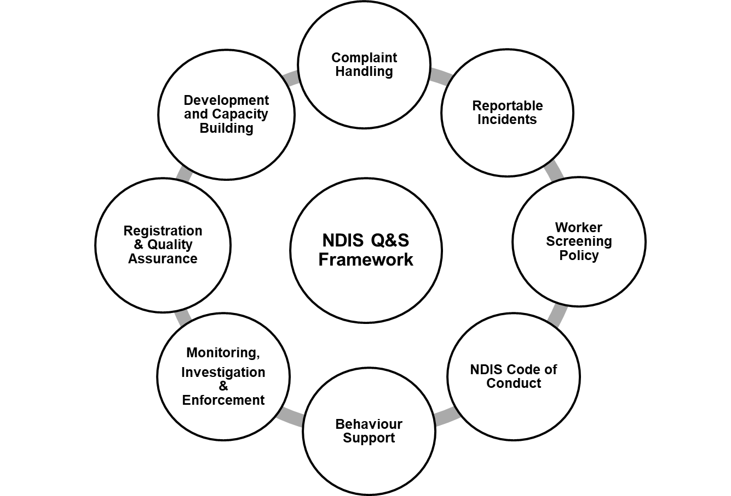
Key components

Slide 4
NDIS Commission Indicative structure

Slide 5
NDIS Commission Establishment

Slide 6
Provider Registration
Registered NDIS Providers will be required to comply with:
NDIS Code of Conduct
NDIS Practice Standards
Complaints management requirements
Incident management and reportable incident requirements
Worker screening
Behaviour support requirements (if applicable)

Slide 7
NDIS Practice Standards
The NDIS Commission will be responsible for registering NDIS providers - they must meet quality and competency standards
Two pathways:
Verification – providers that deliver lower risk, less complex supports or services
Certification - providers that deliver higher risk, more complex supports or services

Slide 8
Phasing in Providers
The registration of existing providers will automatically transfer to the NDIS Commission.
Existing providers of supports will be able to continue their current operations
Providers will be advised directly when to commence registration renewal
Providers will then be expected to commence their new NDIS Practice Standards audit within a particular time frame
The NDIS Commission will monitor completion of the audit process

Slide 9
Complaints
The NDIS Commission will be responsible for handling complaints about NDIS providers
All complaints will be taken seriously and assessed
Some complaints will be appropriate for a facilitated resolution process
Some complaints will require investigation
Registered providers must have internal complaints management arrangements

Slide 10
Reportable Incidents
Death
Serious injury
Abuse and neglect
Sexual or physical assault
Sexual misconduct
Unauthorised use of restrictive practices

Slide 11
Investigative Powers and Enforcement Action

Slide 12
Behaviour Support
NDIS Commission’s Senior Practitioner will provide clinical leadership for behaviour support and the reduction and elimination of restrictive practices
Competency framework for behaviour support practitioners
Use of restrictive practices must be reported
States and territory governments responsible for authorising restrictive practices in their jurisdictions

Slide 13
Worker Screening
Shared responsibility between Commonwealth and state/territory governments.
States and territories: screening units responsible for worker screening checks.
NDIS Commission: work with all governments to develop national policy and standards.

Slide 14
NDIS Code of Conduct
Applies to all providers and workers (registered and unregistered) delivering NDIS supports and services.
Will complement and work alongside other codes of conduct for example, those applying to allied health professionals.

Slide 15
Obligations on providers

Slide 16
What can providers do now to get ready?
Continue to maintain quality and safeguard requirements in each jurisdiction you are registered in
Review your contact details and registration groups on the NDIS Provider Portal
NDIS Practice Standards information sessions – registered providers

Slide 17
Further Information
For more information visit: www.dss.gov.au
NDIS Quality and Safeguards Commission fact sheets for providers, participants and an overview are now available at the DSS website at www.dss.gov.au/ndisqualitysafeguards
Or contact: NDISQualitySafeguards@dss.gov.au

