Slide 1

2020 ESAt Review
Final report
21 august, 2020

Slide 2
Table of contents
1
Executive summary
Summary of recommendations
List of terminology
6
Chapter 1: Context and introduction
32
Chapter 2: Referrals (triggers and triaging)
47
Chapter 3: Program recommendations and work capacity
75
Chapter 4: Further opportunities for change
80
Chapter 5: Implementation and impact assessment
87
Appendix

Slide 3
Executive summary
The recent Mid-Term Review of the Disability Employment Services program (DES) highlighted the unclear value-for-money currently provided, given the rising caseload and spend but soft growth in employment outcomes. Employment Services Assessments (ESAts) are a critical process step in controlling entry into the Disability Employment Services program (DES), allowing for qualitative assessment of the employment barriers faced by job seekers. Ensuring that ESAts are effective, accurate, and consistent is critical to matching appropriate supports to job seekers, and for the ongoing sustainability of DES.
Using analytical and qualitative research, this ESAt Review identified that while ESAts are carried out with a high degree of professionalism, there are suggestions of variation in decision-making patterns, likely due to unclear and generalised guidelines. ESAt assessors face the challenging task of making professional judgments of the severity of barriers to employment faced by a diverse set of ESAt participants. Tightening the guidelines, with clearer specification of what criteria should and should not be used to inform decision-making, will help ensure assessors are equipped to align decisions with policy intent. In addition, a revamped and more tightly targeted Quality Assurance (QA) process will communicate priorities and support information-sharing across assessors. Opportunities also exist to free up assessor workload by eliminating the compulsory ESAts that take place after 18 months of participation in DES.
It is estimated that these changes could result in a net reduction of referrals into DES of between 2 to 7 per cent, translating to a reduction in DES spend of between $25–90m by 2022-23, along with better matching of individuals to the supports available. Given these implications, a rapid implementation timeline is proposed. However, it is important to allocate time for cross-Commonwealth stakeholder engagement, to avoid any unintended consequences of ESAt changes.
Nonetheless, adjustments to ESAts alone will make a moderate impact at best on the issues identified by the Mid-term DES Review. Broader, more fundamental reconsideration of DES design and eligibility is required. In addition, the complexity of organisational oversight for DES entry – where three policy agencies and one service delivery agency all have varying responsibilities and interests across the end-to-end process – emphasises the importance of the Mid-term Review's recommendation to consolidate the governance of the Commonwealth's employment services programs.

Slide 4
Chapter-by-chapter overview
Chapter | Content
Chapter 1: Context and introduction | Description of flagship employment services programs and the role of ESAts and JSCIs in managing program access Recent history of rapidly increasing caseload and spend in DES, alongside soft employment outcome growth, and the underlying causes of that growth Scope, timeline, and methodology of the ESAt Review
Chapter 2: Referrals (triggers and triaging) | Overview of the process by which ESAts are triggered (via new registrations / JSCIs, Change of Circumstance Reviews (COCRs), DES 18-Month Reviews, and DSP applications) and then triaged by Services Australia prior to assessment Pain points and opportunities for trigger reform: proposed removal of DES 18-Month Reviews, increased scrutiny of COCRs Automation of triage efforts by Services Australia
Chapter 3: Program recommendations and work capacity assessments | Observations from interviews and data regarding consistency and accuracy of ESAt assessments, for both program recommendations and work capacity Recommended approaches to tightening up ESAt guidelines, accompanying revisions to Quality Assurance to embed and support change, and enforcing ESAt outcomes
Chapter 4: Further opportunities for change | Identification of the need for additional data to support ESAt design and DES eligibility policy decisions Considerations for ESAt design in the context of broader DES redesign
Chapter 5: Impact assessment and proposed implementation | Scoping potential impact of changes on DES referral count and spend Proposed timeline for recommendation implementation, including immediate next steps

Slide 5
Summary of recommendations
Referrals (triggers and triaging)
Program recommendations and work capacity assessments
Further change opportunities
Recommendations
Ensure changes to the JSCI as part of the new jobactive model consider the impact on ESAt referrals through consultation between DESE, Services Australia, DSS and the NIAA
Update the pre-listed medical conditions which automatically trigger an ESAt referrals through the JSCI, informed by the likelihood of achieving a useful ESAt outcome
Increase reviews of provider initiated change of circumstances and clarify when to initiate a COCR review (e.g. new medical evidence should only be actioned if it is likely to change work capacity or required supports)
Remove the DES 18-Month Review. Alternatively, conduct 18-Month Reviews as file assessments
Continue improving the accuracy and efficiency of ESAt referrals triggered by the online JSCI. This could include adding new questions to the JSCI, or an alternative screening process
Ensure the "Screeni Bot" automation is effective and integrates well within current operations (including passing Business Verification Testing). This should include ongoing auditing and recalibration
As already planned by Services Australia, continue to build out complementary automations for ESAt booking and report writing
Recommendations
Update ESAt guidelines to be clearer and have more specific criteria
Provide more examples of correct ESAt decisions, aligned to updated program guidelines and covering more "borderline" cases
Use analytics to target assessor quality assurance activities (e.g. comparison to overall program results, regional results, or to expected results after normalising for other factors)
Conduct standardised QA testing across assessors using file assessments, with a focus on "borderline" decisions
Provide selective, data-based feedback to assessors to address potential bias. For example, this could be informed by comparison of individual assessor results to program level results
Collect data on actual hours worked (e.g. by work capacity band, disability type) to inform assessor training
Examine opportunities to enforce Grant Agreement clauses regarding DES exits following an ESAt recommendation to another program
Recommendations
Conduct more extensive data-gathering to inform ESAt design and DES eligibility decisions
Reconsider ESAt policy in context of DES re-design
All recommendations were produced by BCG under the terms of reference of the ESAt Review, and do not necessarily reflect the views of the Commonwealth Government.

Slide 6
List of terminology used in this review
Term | Description
ADE | Australian Disability Enterprises
COCR | Change of Circumstances Review
DES | Disability Employment Services
DMS | Disability Management Service (DES stream)
ESS | Employment Support Service (DES stream)
Disability | Includes sensory impairment, physical impairments, learning disabilities, mental health conditions or behavioural conditions, and injuries and chronic illnesses, and including both permanent and temporary disabilities
DESE | Department of Education, Skills and Employment
DSP | Disability Support Pension
DSS | Department of Social Services
Employment Assistance | The program services provided to a participant prior to achieving an outcome. This continues for a maximum of 18 months, included all prescribed program services to participants who are not receiving Post Placement Support, or until the participant exits the program, starts Ongoing Support, or transitions to Post Placement Support.
ESAt | Employment Services Assessment
Grant Agreement | The Disability Employment Services Grant Agreement, effective as of 1 July 2018 until 30 June 2023. This may be extended up to an additional 10 years at the Department’s option.
Term | Description
JCA | Job Capacity Assessment
JSCI | Job Seeker Classification Instrument
NIAA | National Indigenous Australians Agency
Non-medical barriers | Barriers to employment not related to medical conditions. This includes vocational barriers, special needs barriers (e.g. risk of homelessness) and personal factors (e.g. alcohol dependence, relationship breakdown)
Ongoing Support | Services provided to a participant who are assessed as requiring further support in the workplace. This is determined through an Ongoing Support Assessment and is available to participants who have achieved a 26-week Employment Outcome or a Work Assistance, and are currently employed.
Post Placement Support | Services provided to a participant after starting an education or training activity while they are working towards an outcome, unless the participant is in Ongoing Support.
QA | Quality Assurance
SA | Services Australia
TtW | Transition to Work

Slide 7
Next section: Chapter 1
1
Executive summary
Summary of recommendations
List of terminology
6
Chapter 1: Context and introduction
32
Chapter 2: Referrals (triggers and triaging)
47
Chapter 3: Program recommendations and work capacity
75
Chapter 4: Further opportunities for change
80
Chapter 5: Implementation and impact assessment
87
Appendix

Slide 8
Chapter 1 summary: Context and introduction
1
1.1. Entry to flagship employment services programs is managed through JSCIs and ESAts
DES and jobactive are flagship employment services programs, responsible for ~$850m and $1.4b of spend in 2018-19 respectively, where non-government providers are offered incentive payments to assist job seekers in finding employment. DES is intended for individuals for whom disability is their primary barrier to employment. In remote areas, the function of both programs is replaced by the Community Development Program (CDP). Oversight of these programs is split between DSS, DESE, and the National Indigenous Australians Agency (NIAA), with Services Australia as the key delivery partner (including ESAts management).
A two-stage process manages entry into these programs:
  Job seekers complete the JSCI questionnaire, identifying where they might have substantive barriers to employment (including work capacity limitations, disability, or non-disability barriers such as homelessness). JSCI results will flag the possible need for an ESAt to Services Australia, who perform triaging before an ESAt takes place;
  Triaging then decides who undertakes an ESAt, where an interview by an appropriately qualified individual (e.g. allied health professionals) results in a recommendation for which program an individual should join, and assesses their weekly work capacity.
1.2. Declining DES performance has drawn attention to role of ESAts
The DES caseload has grown rapidly in recent years, while employment outcomes achieved have been soft and program efficiency has fallen. Variations in program design between DES and jobactive have attracted relatively hard-to-place individuals into DES. The 2020 Mid-term DES Review suggested:
  Eligibility for DES should be optimised, to ensure a focus on individuals who gain the most benefits compared to baseline outcomes;
  The ESAt process may also need to be adjusted, to ensure accuracy and consistency in decision-making under current selection criteria.
  1.3. BCG commissioned to conduct ESAt Review with broad scope and at speed, using multiple lines of evidence
  Consequently, BCG was commissioned to support the Department of Social Services in a four-week, end-to-end review of the ESAt process, spanning the initial triggering of ESAts by JSCIs, the triaging of triggered ESAts prior to assessment, the assessment process itself, and broader opportunities for change and reform. The ESAt review leveraged wide-ranging stakeholder and assessor interviews, as well as analysis of multiple-million row datasets.

Slide 9
Section 1.1
Two-stage entry process into employment services programs is managed through JSCIs and ESAts
1.1
  jobactive, DES, and CDP are flagship employment programs
  Employment services programs overseen by the Commonwealth span:
    jobactive, a large "mainstream" service
    DES, supporting individuals whose primary barrier to employment is disability
    CDP, offering remote area services
    Other programs e.g. Transition to Work (TtW), ParentsNext
  Program entry is regulated by JSCIs and ESAts
  JSCI provides initial questionnaire –based assessment
  For selected individuals, the interview-based ESAt recommends a program and assesses participant work capacity
  Policy and delivery is split between four agencies
  DESE oversees jobactive and JSCI policy
  DSS oversees DES and ESAt policy
  NIAA oversees CDP
  Services Australia is a key delivery partner across agencies, including administering ESAts for DSS

Slide 10



DES, jobactive, and CDP are flagship employment support services programs
1.1
 | Jobactive | Disability Employment Services | Community development programme
Description | "Mainstream" non-remote employment services program | Specialist disability support service | "Mainstream" remote employment services program
Caseload (March 20¹) | 757,316 (note: approximately 1.5m following COVID-19) | 280,180 | 32,145
Key criteria for entry | Job seekers who do not quality for DES or CDP, in addition to other eligibility criteria | Disability as primary barrier to employment | Job seekers living in designated remote areas of Australia
Segmentation structure | Streams (determined by JSCI and ESAt) Stream A - most job ready, on a relative basis Stream B - some employment barriers Stream C – Non-vocational employment barriers | DMS – job seekers with disability, injury or health condition who require employment assistance, not expected to need long-term workplace support ESS – job seekers with permanent disability who require long-term Ongoing Support | No segmentation
Funding approach | Combination of duration of unemployment, stream (which incorporates JSCI), and regional loading combined with stream | Funding Levels, based on algorithmic assessment of participant characteristics and likelihood of finding a job | Service payments based on Work for the Dole (WfD) eligibility and participation in WfD activities. Employment outcome payments based 13 and 26 week achievements
Market | 39 providers Market caps for providers Limited participant choice | 110 providers No market caps Choice of provider | 46 providers in 60 regions No participant choice – only one provider in each region
Dependency on ESAts | Eligibility for Stream C Exemption from mutual obligations requirement Related employment programs – e.g. Transition to Work – may have ESAt dependencies Affects provider payment rates | Eligibility Inform funding arrangements Work capacity assessment | Eligibility Inform funding arrangements Exemption from mutual obligations requirement
Use of work capacity assessments | May determine mutual obligation hours | Affect classification of employment outcomes as either "pathway" or "full", with the latter resulting in ~3x higher payments to providers | May determine mutual obligation hours
Program spend (FY19) | ~$1,400m | ~$900m | ~$300m
Managed by… | Department of Education, Skills and Employment | Department of Social Services | National Indigenous Australians Agency
1. Note that caseloads across all programs have grown rapidly since the March quarter 2020, due to the impact of COVID-19.
Source: CDP Regional Data Report 2018-19, CDP Head Agreement; DJSB Portfolio Budget Statements; DSS Portfolio Additional Estimate Statements; DES Mid-Term Review report; BCG analysis

Slide 11
Entry to DES, jobactive, and CDP is managed through JSCIs and ESAts
(while JCAs manage eligibility for DSP)
1.1
 | JSCI | ESAt | Job Capacity Assessment (JCA)
Description | Most job seekers complete the JSCI when they first register for employment assistance with Services Australia and when there is a change in their circumstances Initial assessment to determine the appropriate employment service for the job seeker (those with more complex barriers or needs may complete the JSCI as well as ESAt/JCA) | Used to assess barriers to finding and maintaining employment work capacity (in hour bandwidths) interventions/assistance that may be of benefit to improve their current work capacity | Used to determine qualification for DSP based on level of functional impairment current/future work capacity barriers to finding/maintaining employment JCA contains a complete ESAt
Format | Survey consisting of up to 49 questions (min. of 18 questions) | ~30 minute interview, conducted by an allied health professional | ~1 hour interview by phone or video conference
Performed by | Participant (survey) Services Australia staff or employment service provider | Health or allied health professional | Clinical health professional
Outputs | Numerical JSCI score – higher the score, the higher likelihood of remaining unemployed for at least 12 mths Recommendations for ESAt trigger, social worker trigger, language literacy and numeracy | Report on identified barriers to work Estimate of work capacity, including: temporary reduced work capacity, baseline work capacity and with intervention capacity Recommendation of referral into relevant employment program and stream | Outcome on qualification for receiving DSP Work capacity for Fully diagnosed, treated and stabilized conditions
# conducted per year (2019-20) | >1m | 261,811 | 51,961
Managed by… | Department of Education, Skills and Employment | Department of Social Services | Department of Social Services
Source: Employment Services Assessments, Services Australia; Social Security Guide; Job Capacity Assessment, Services Australia; jobactive Assessments; DESE Guideline

Slide 12
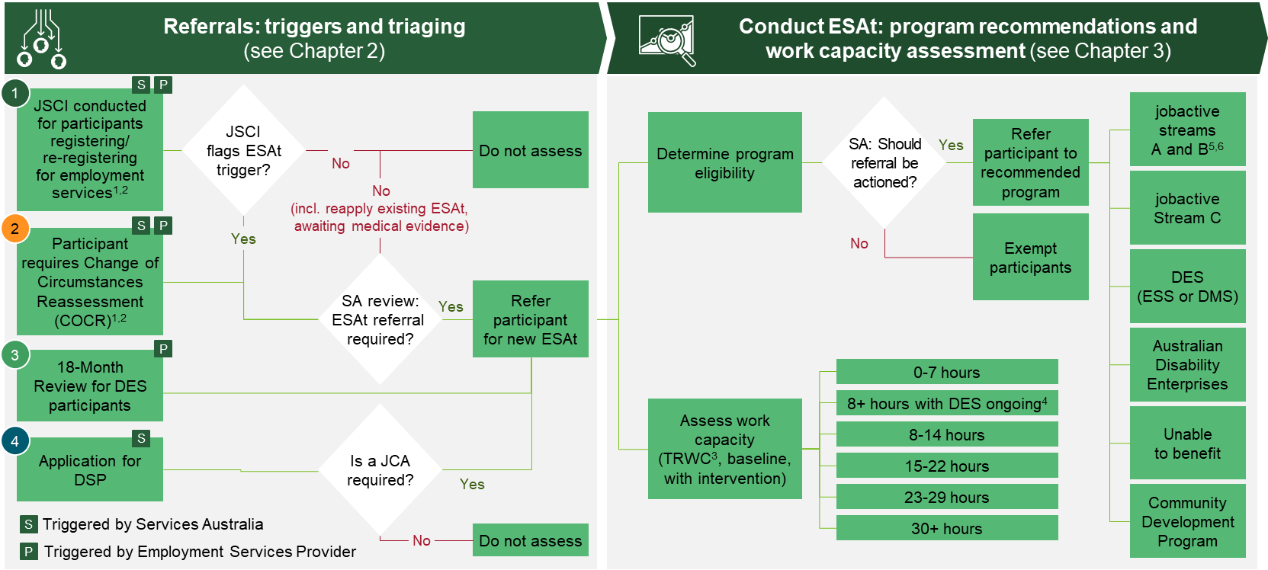
End-to-end ESAt process spans two stages: referrals (triggers and triaging), and the assessment itself (program recommendation and work capacity assessment)
1.1
1. JSCI not required in all cases 2. Restrictions apply to provider referrals 3. Temporary Reduced Work Capacity 4. For participants who will only be able to reach 8 or more hours work a week with DES ongoing support. Applies to With Intervention work capacity only 5. Stream determined by JSCI score 5. Participant may be subsequently referred to TtW
Source: ESAt and JSCI Instrument Overview; ESAt referral information; ANAO 'Qualifying for the Disability Support Pension'; BCG analysis

Slide 13
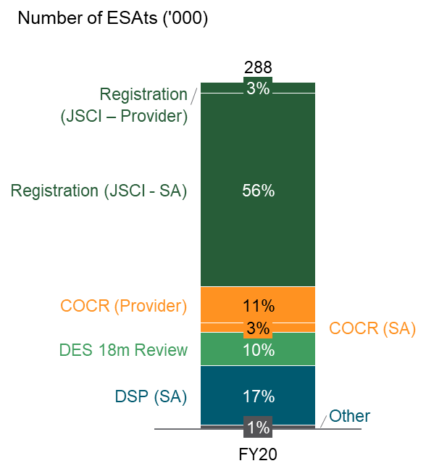
ESAts are mainly triggered through four channels
1.1
Description of ESAt triggers
Majority of ESAts triggered by JSCIs on registration for employment services
1
Registration for employment services with JSCI trigger
  Participant undergoes a JSCI when they register or re-register for employment services
  JSCI triggers an ESAt depending on the participant's responses to medical, special needs or personal factor questions
2
Change of Circumstances Review (COCR)
  Services Australia or the participant's provider may refer the participant for an ESAt if their circumstances change in a way which may influence their ESAt result
  For example, provision of new medical evidence
3
DES 18-Month Review
  DES participants undergo a "Program Review" after 18 months in "Employment Assistance" to determine if they will benefit from an further 6 months in DES
  This is conduct through an ESAt, unless the participant is undertaking employment or training, or otherwise exempt
4
DSP application, resulting in a JCA
  Participants who apply for the Disability Support Pension, meet the non-medical claims criteria but not the manifest criteria are required to undergo a Job Capacity Assessment, which includes an ESAt
Note: Other includes Foreign Pension, Sickness Allowance, Youth Disability Supplement and Temporary Incapacity
Source: ESAt and JSCI Instrument Overview; ESAt referral information; DSS; BCG analysis

Slide 14
JSCI triggers an ESAt referral based on participant's particular medical conditions or if medical condition impacts ability to work
1.1
Current JSCI medical triggers for an ESAt
Medical triggers | Additional detail
Does the participant have one of the pre-listed conditions (medical, disability, addictions)? | Acquired Brain Impairment, Anxiety, Anorexia Nervosa, Bi Polar Affective Disorder (Manic Depression), Bulimia, Depression, Emotional Disturbance, Child/Adolescent, Intellectual Disability, Learning Disability, Obsessive Compulsive Disorder, Other Psychological/Psychiatric disorder, Paranoid, Personality Disorder, Phobias, Post Traumatic Stress disorder, Psychosocial Deprivation, Psychotic, Schizophrenia, Toxic Brain Injury, Traumatic Brain Injury
Participant considers they are unable to work at least 30 hours per week | --
Medical condition which affects the type of work a participant can do | --
Medical condition which results in participant requiring additional support in the workplace | --
Note: Triggers only apply to disabilities that the job seeker considers will last for three months or longer, or is not sure whether they will last for this duration
Source: ESAt Triggers Document provided by DESE

Slide 15
JSCI triggers an ESAt referral if participant has special needs or personal factors impacting their ability to obtain employment
1.1
Current non-medical triggers for an ESAt
Special needs triggers | Additional detail
21 or younger and satisfies any one of the specific triggers: | Sole parent Mostly unemployed in past two years Stability of residence (e.g. required emergency or temporary housing, moved 4+ times in the past year) Risk of homelessness Highest level of education is less than year 10 Ex-offender Indigenous Socially isolated (parents were not regularly paid work in early teens)
22 or older and receives any three of the specific triggers | All factors listed above (excl. sole parent, indigenous, socially isolated) Low English Language and Literacy skills
Recent crisis payment recipient | Received crisis payment in the 6 months before initial registration or annual review
Personal factors triggers | Additional detail
Any of the following factors | Drug dependence Personal crisis or trauma (incl. domestic violence, grief, etc.) Vertigo Drug treatment program Gambling addiction Severe stress Anger issues/violence Relationship breakdown Arrived in Australia on refugee/humanitarian visa in the past 5 years
Note: "sleep problems/insomnia" or "self esteem/motivation / presentation issues" adds to the JSCI rather than triggering an ESAt referral
Source: ESAt Triggers Document provided by DESE

Slide 16
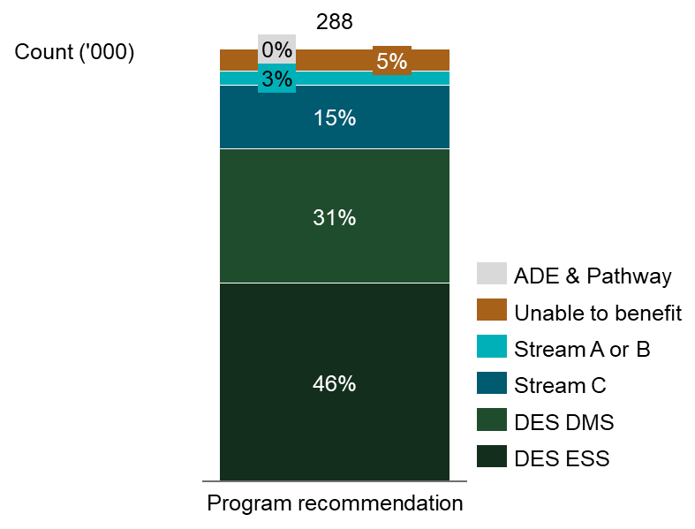
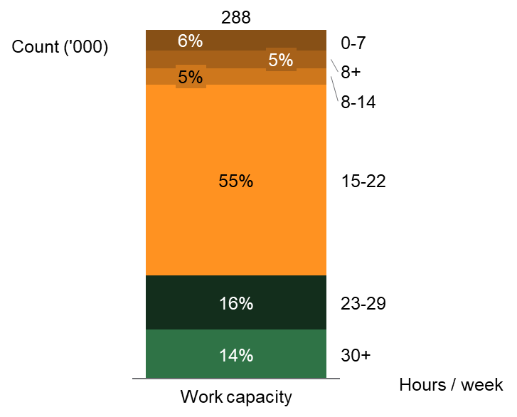
More than three-quarters of completed ESAts recommend DES, and 70 per cent are assessed as low work capacity (<23 hours/week)
1.1
About 77 per cent of completed ESAts recommend DES program for participants
About 65 per cent of completed ESAts result in work capacity assessments under 23 hours/week
Distribution of ESAt program recommendations (2019-20)
Distribution of ESAt program recommendations (2019-20)
Source: DSS; BCG analysis

Slide 17
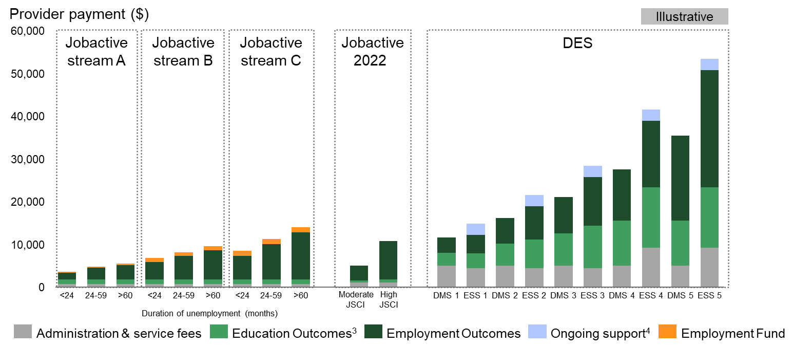
Accurate program recommendations are necessary not only to ensure that participants access appropriate supports, but to manage spend sustainability
1.1
Fee payments resulting from an illustrative, simplified participant journey^{1,2}
  Note
  Jobactive and DESE differ in funding structures:
  by stream and period
  of unemployment (Jobactive), versus by DMS/EMS funding
  level (DES)
  Journey shown assumes:
    Full outcome payments. In practice, payments would be a mix of full and pathway
    Full eligibility for all payments. In practice, relatively few participants are eligible for education payments on jobactive
1. Assumes 18 months seeking employment prior to undertaking education and gaining an employment outcome 2. Excludes work for the dole fees for jobactive 3. Eligibility for education outcomes more restricted in jobactive vs DES 4.Ongoing support payment based on quarterly moderate ongoing support payment (min. 6 contacts over 3 mths, ESS only), participants may also receive flexible or moderate support
Note: Illustrative pathway for a 26-week outcome, does not include bonus payments, participant flows vary. jobactive figures for non-regional locations
Source: DSS DES Grant Agreement 2018, DESE jobactive Deed 2015-2020

Slide 18
Accurate work capacity assessments are necessary to avoid the negative impacts of under- and over-estimates
1.1
Impact of underestimating or overestimating work capacity:
 | Participant employment outcomes | Government expenditure | Provider economics
Overestimating work capacity | Participant will not be unable to sustain employment in the role Provider will focus efforts on participants who can more easily meet their benchmark hours | Higher income support payments if participant is unable to gain employment | Providers less likely to receive full outcome payments (which are 3x the value of pathway outcomes), impacting sustainability
Underestimating work capacity | Provider has less incentive to place participants into roles with greater hours | Participants more likely to remain on income support, even after achieving an employment outcome Granting a medical exemption (via a temporary reduced work capacity) can result in participant being stuck in unemployment cycle by delaying return to work Higher cost of paying providers for full outcomes | Providers more likely to achieve full outcome payments without justification
Source: DSS; BCG analysis

Slide 19
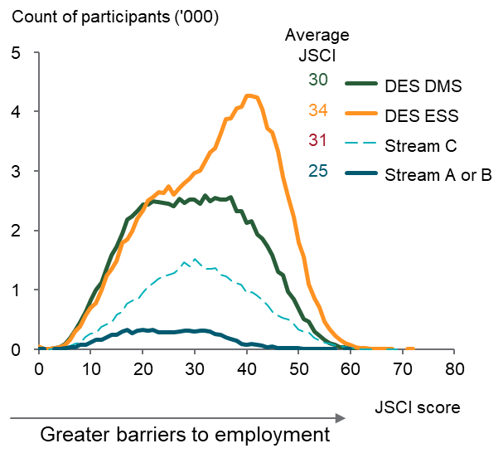
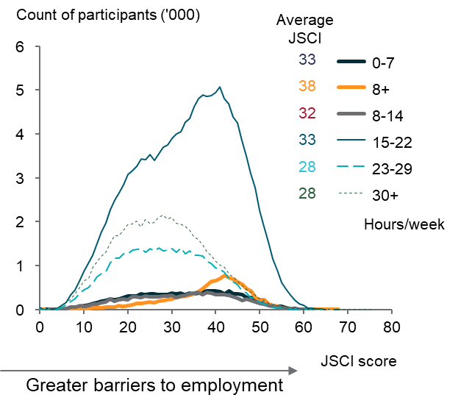
JSCI scores are only weakly correlated with ESAt results, illustrating how ESAts add nuance to assessments
1.1
JSCI scores overlap across program recommendations and work capacity estimates
JSCI scores reflects a job seeker's relative disadvantage in the labour market which alone is an insufficient basis for decision-making as programs such as DES specialise in addressing a particular type of barrier (i.e. disability) rather than an overall disadvantage level.
Work capacity and medical conditions are also factors in the JSCI, hence higher work capacities are on average associated with lower JSCI scores
JSCI scores by program referral (FY20)
JSCI scores by work capacity (FY20)
1. <23 hours/week
Source: DSS; BCG analysis

Slide 20
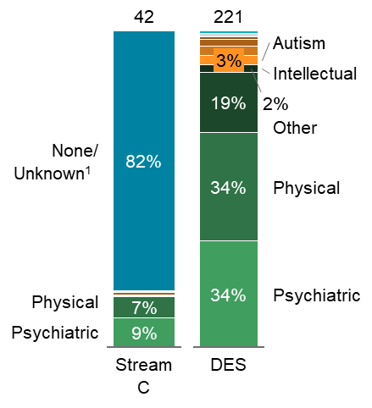
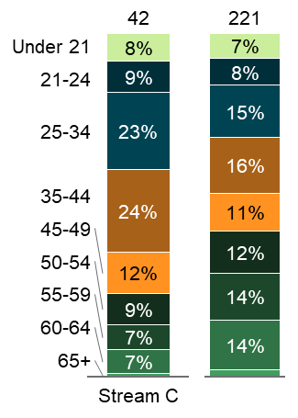
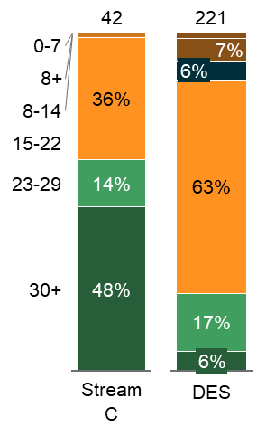
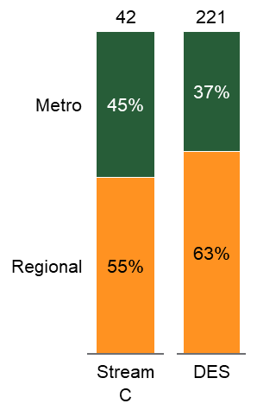
Systematic differences observed between jobactive Stream C and DES participants
1.1
Majority of participants referred to Stream C have not provided evidence of a disability… (’000)
…in general, have a relatively younger age profile… (’000)
… relatively high work capacity in comparison to DES… (’000)
… and are also slightly more likely to live in metropolitan areas (’000)
1. At the time of referral no primary disability was recorded with supporting evidence .
Note: For 2019-20. Assumes NA work capacity to be 30+. 8+ work capacity category is for DSP participants. Unknown geography refers to sensitive individuals that do not have their postcode disclosed. Characteristics of referred participants may not entirely equate with actual participants on the program.
Source: DSS; BCG analysis

Slide 21
Section 1.2
Declining DES performance and rising costs has drawn attention to role of ESAts
1.2
  Following the 2018 reforms, DES caseload grew substantially, but employment outcome growth has been soft, resulting in declining overall efficiency
  Changes in incentives for providers and participants have encouraged caseload growth, particularly for volunteers and former jobactive participants
  In recent years, ESAts are:
    Increasingly provider-initiated
    More likely to recommend individuals towards DES, rather than jobactive Stream C
    Tend to give lower assessments of work capacity
  The relatively high expense of DES, the importance of accurate work capacity assessments, and the criticality of ensuring DES is targeted towards those who benefit the most, all emphasise the importance of ensuring ESAts are operating effectively

Slide 22
The 2018 DES reforms expanded eligibility for education outcomes and supported participant choice
1.2
Six major planks to 2018 reforms:
1
Expanded access to education outcomes. Fees paid to providers increased substantially, as well as
participant eligibility.
2
Increased competition and contestability. Removal of market share caps for DES providers.
3
Increased participant choice. Allowing participants to change providers up to five times during their time in the program, without prerequisites.
4
Introduced a risk-adjusted funding model. Splitting funding tiers into five levels across both ESS and DMS participants, with funding based on actuarially-assessed difficulty of placement.
5
Rebalanced fees towards outcomes and away from services. Adjusting fee rates to move towards 50-50 service-outcome split, rather than 60-40.
6
Encouraged longer-term employment placements. Among other changes, introduction of 52-week employment outcome fees, elimination of "placement" fees in favour of 4-week outcome fees.
Source: DES Mid-term Review

Slide 23
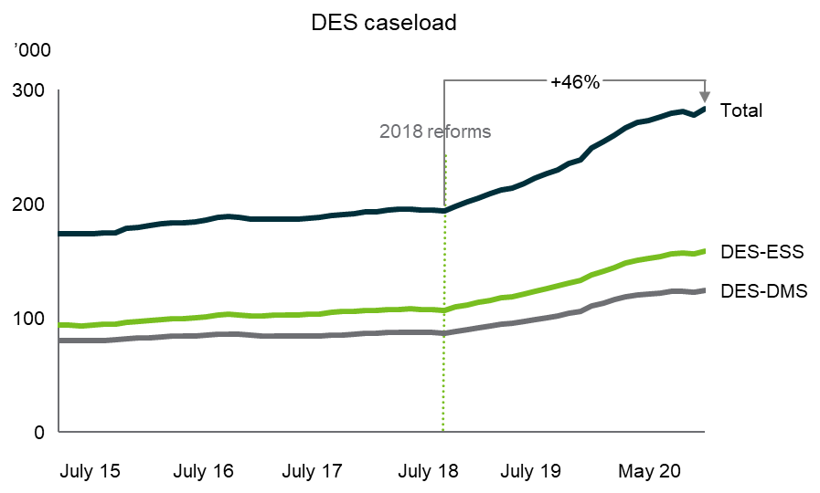
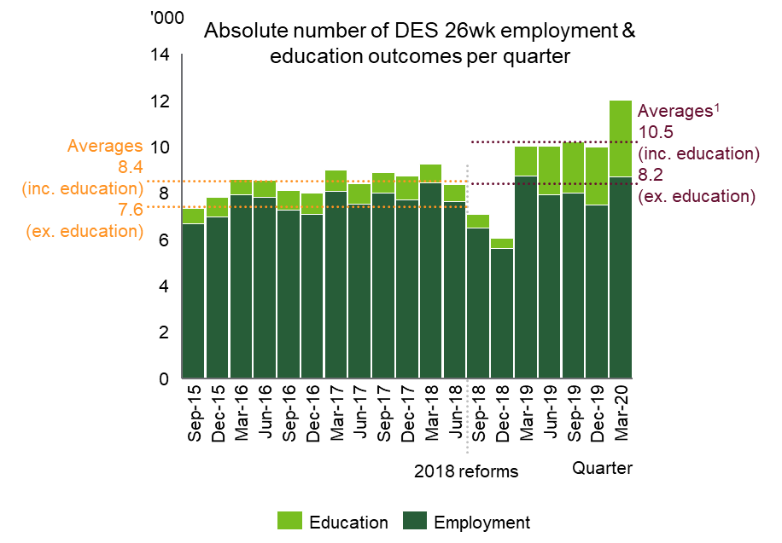
DES showed rapid caseload growth post-reforms, despite relatively flat employment achievement
1.2
Caseload has grown by 46 per cent following the reforms
The number of employment outcomes
achieved per quarter has been broadly flat
Note: Includes participants who are commenced, suspended, and referred but not yet commenced. 1. Excludes Sep-18 and Dec-18 quarters in weighted average calculation
Source: DSS; BCG analysis

Slide 24
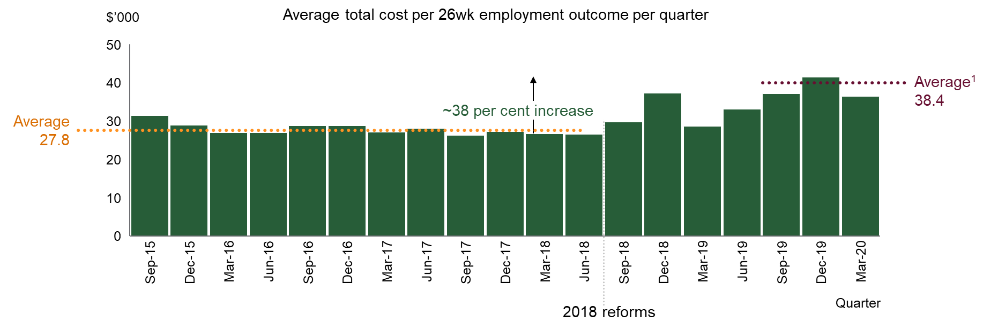
Consequently, DES efficiency (measured by average costs per employment outcome achieved) has declined
1.2
Average spend per 26wk employment outcomes is ~38 per cent higher, on average, post reforms
1. Excludes Sep-18 to Jun-19 quarters in average, due to understatement of total costs as a result of funding level issues (~$20m was refunded to providers, timing not recorded in available dataset).
Source: DSS; BCG analysis

Slide 25
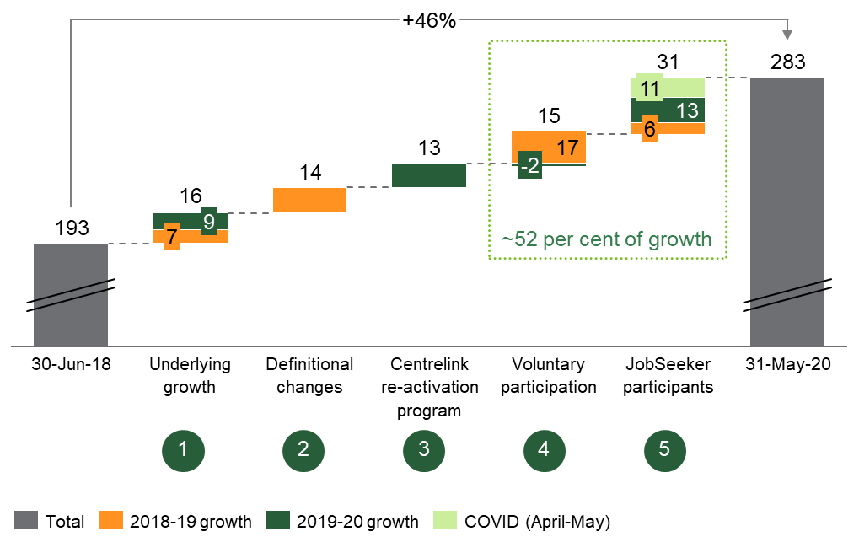
Approximately half of DES caseload increase driven by JobSeeker participants and volunteers
1.2
DES total caseload ('000)
Reason for growth:
1
  Underlying growth of DES of 3.8 per cent p.a. from
  2014-15 to 2017-18
2
  Definitional changes due to the introduction of 52 week outcomes resulting on participants staying on caseload for longer
3
  One-off Centrelink re-activation program for participants with mutual obligations who were inactive due to system faults
4
  Higher voluntary participation, due to provider behavior after removal of market share caps
5
  High growth in JobSeeker participants, not accounted for by other factors including +11k in the COVID-19 period
Notes: Figures are for total caseload, including suspensions
Source: DSS; BCG analysis, EY DES Caseload and Cost Analysis

Slide 26
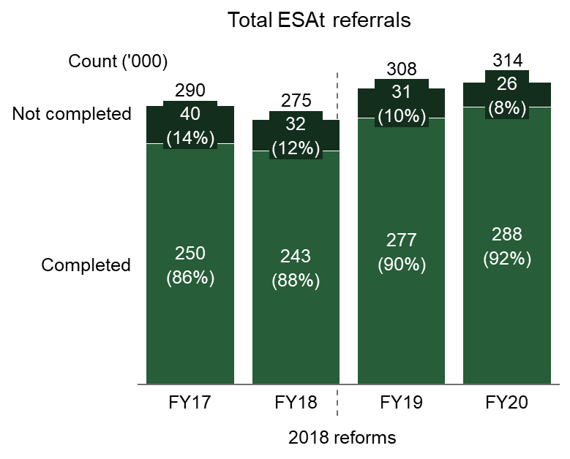
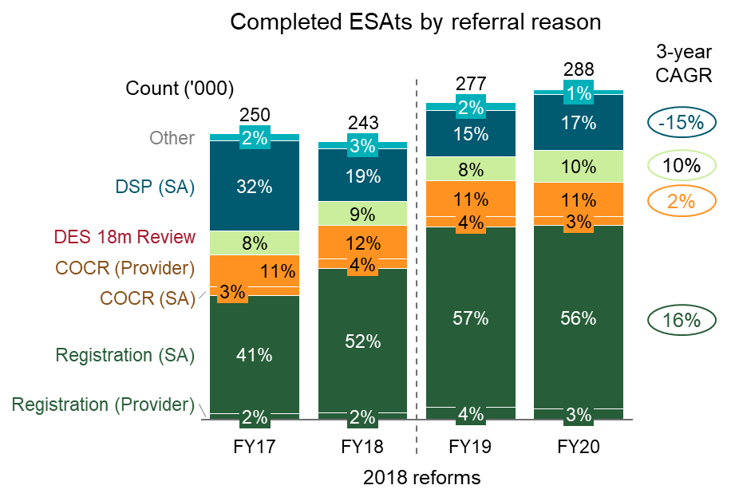
Bulk of ESAt growth due to new registrations from the introduction of pre-vetting, along with increased use of telephone-based interviews
1.2
Increased use of telephone interviews
has raised the ESAt completion rate
Pre-vetting services for DSP claims in mid-2017 caused ineligible DSP individuals to take the ESAt instead
Note: The most common reason for an ESAt not being completed is participant failure to attend the interview.
Source: DSS; BCG analysis

Slide 27
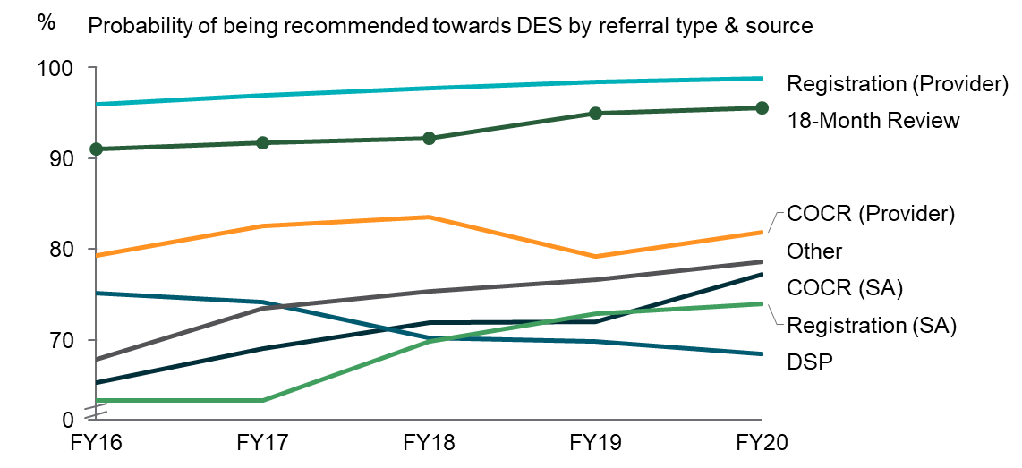
Majority of referral types are increasingly likely to recommend participants towards DES
1.2
Overall upward trend in DES recommendations across referral sources
New registrations, COCR and DES 18-Month Reviews ESAts have increased in both absolute numbers (as per previous slide) as well as likelihood of recommending DES
Both factors are associated with increasing DES caseload
Note: All DSP referrals reasons require a JCA, which inherently includes an ESAt. The majority of DSP referrals are for new DSP claims although there is a minority of DSP Medical Review, DSP Appeal referrals etc, which have all been discontinued and slowly phased out
Source: DSS; BCG analysis

Slide 28
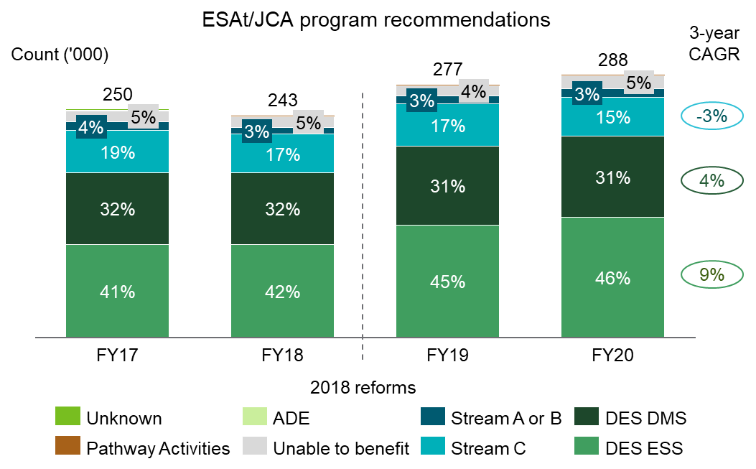
ESAts are increasingly likely to recommend participants towards DES ESS, which offers Ongoing Support and has higher outcome fees
1.2
DES ESS program recommendations are by far the fastest-growing category
Increase in DES ESS recommendations is driven by both the increase in volunteers (often DSP recipients) and individuals who have been rejected from DSP but have some form of long-term disability
Source: DSS; BCG analysis

Slide 29
The importance of accurate program recommendationsand work capacity assessments underscores the importance of ensuring effective ESAt operations
1.2
  Program recommendations need to balance both ensuring appropriate supports are available, with maximising the impact of the Commonwealth's limited resources
  Important to ensure that both…
    Individuals who face disability as the primary barrier to employment are able to gain access to DES
    Individuals better served by other programs are streamed appropriately
  Note that DES is multiple times higher in cost, on average, per participant than jobactive Stream C
  Context of rapidly rising caseload raises importance of ensuring ESAt process is operating effectively
  Consequently in mid-2020 the Department of Social Services commissioned an end-to-end review of ESAts
Source: DSS; BCG analysis

Slide 30
Section 1.3
BCG engaged to conduct ESAt Review with broad scope and at speed, using multiple lines of evidence
1.3
  ESAt Review scope spanned four questions:
  Is the ESAt referral process functioning effectively?
  Do ESAts make accurate and consistent decisions, for both program recommendations and work capacity assessments?
  What broader changes to ESAt context and oversight should be investigated?
  What are the restrictions to and implications of changes, and what is the possible timeline and pathway of reform?
  Review timeline covered four weeks, from July to August 2020
  BCG worked with DSS to deploy multiple methodologies
    ESAt Review completed as an extension to BCG's support of the 2020 DES Mid-term Review
    BCG deployed an expert team, conducting interviews with both stakeholders and operational staff, and analysing multiple-million row datasets

Slide 31
The scope of the ESAt review spanned four issues, covering the end-to-end ESAt process and the opportunities for future change and reform
1.3
Chapter 2:
Is the ESAt referral process functioning effectively?
Chapter 3:
Do ESAts make accurate and consistent decisions, for both program recommendations and work capacity assessments?
Chapter 4:
What broader changes to ESAt context and oversight should be investigated?
Chapter 5:
What are the restrictions to and implications of changes, and what is the possible timeline and pathway of reform?

Slide 32
BCG partnered with DSS to deliver the ESAt Review, deploying a combination of qualitative and quantitative methodologies
1.3
  Leveraging the team that conducted the 2020 DES Mid-term Review, BCG deployed a mix of expert economists, policy analysts, and quantitative researchers
  Delivery of the ESAt Review encompassed:
    Engagement with Commonwealth stakeholders across the Departments of Social Services, Education, Skills and Employment, Prime Minister and Cabinet, and Services Australia, as well as with Comcare
    A series of interviews and observation sessions conducted with operational staff:
      Interviews with 6 ESAt assessors
      Observation of 11 ESAts
      Interviews with 1 JSCI assessor
    Combined analysis of multiple data sources:
      Historical data on ~1.3m ESAts conducted over the five years spanning 2015-16 to 2019-20
      Historical data on activity and outcomes for DES participants over the same period, spanning over 1m rows
      Profiles of ESAt assessors
      Aggregated data on JSCI participants, completion rates, and triggers

Slide 33
Next section: Chapter 2
1
Executive summary
Summary of recommendations
List of terminology
6
Chapter 1: Context and introduction
32
Chapter 2: Referrals (triggers and triaging)
47
Chapter 3: Program recommendations and work capacity
75
Chapter 4: Further opportunities for change
80
Chapter 5: Implementation and impact assessment
87
Appendix

Slide 34
Chapter 2 summary: Referrals (triggers and triaging)
2
  ESAts are mainly triggered for four reasons:
  A participant registering for employment services;
  A change of circumstances review requiring an ESAt being initiated by a provider or Services Australia;
  Reviews for DES participants that occur after 18 months participation;
  Applications for DSP ¹.
  The JSCI triggers for an ESAt appear to be functioning well, with opportunities for some relatively minor refinements:
  Update the pre-listed medical conditions which automatically trigger an ESAt referrals, informed by the likelihood of achieving a useful ESAt outcome;
  Ensure changes to the JSCI being designed as part of the new jobactive model consider the impact on ESAt referrals. This should includeconsultation with Services Australia, DSS and the NIAA.
  While the ESAt change of circumstances review mechanism results in change in outcome for the participant 48 per cent of the time, there is opportunity ensure these reviews are more targeted. It is recommended that Services Australia increase the reviews of provider-initiated COCR and clarify the appropriate reasons for a COCR.
  However, the DES 18-Month Review is a pain point for multiple stakeholders while offering low benefits. It is recommended that 18-Month Review is removed, noting this requires Government approval and provider consent. This would allow assessor work effort to be re-prioritised on higher value tasks and reduce ESAt waiting times.
  Section 2.2: ESAt triaging
  After an ESAt is triggered by the JSCI, Services Australia conducts a triaging process prior to the ESAt being carried out. This triaging has historically been conducted manually and involved triaging during the participation interview. However, this process has recently changed due to the introduction of the online JSCI ("Job Seeker Snapshot") and process automation by a tool called "Screeni Bot". While BCG not reviewed the operations of this tool, there are clear benefits to automation as a general principle, and Screeni Bot appears to have been welcomed by Services Australia staff.
  Recommendations to improve the triaging process include:
  Continue improving the accuracy and efficiency of ESAt referrals triggered by the online JSCI. This could include adding new questions to the JSCI, or an alternative screening process;
  Ensure the "Screeni Bot" automation is effective and integrates well within current operations (including passing Business Verification Testing). This should include ongoing auditing and recalibration;
  As already planned by Services Australia, continue to build out complementary automations for ESAt booking and report writing.
1. DSP application triggers are not considered in detail as part of this review
Source: BCG analysis

Slide 35
Chapter 2: ESAt triggers and triaging
2

Slide 36
Section 2.1
ESAt triggers
2.1
Observations
ESAt triggers appear to function effectively, however the DES 18-Month Review has limited benefit
  JSCI medical condition triggers for an ESAt appear appropriate, however there is an opportunity to make minor updates to the conditions which are pre-listed as ESAt triggers
  DESE is re-designing the JSCI as part of the new jobactive model being introduced on 1 July 2022
  Change of Circumstances Review ESAts change program recommendation or work capacity 48 per cent of the time
  DES 18-Month Review provides limited value, creates ~$4m in cost and workload for assessment services, and negatively impacts participant experience
Recommendations
  Ensure changes to the JSCI as part of the new jobactive model consider the impact on ESAt referrals through consultation between DESE, Services Australia, DSS and the NIAA
  Update the pre-listed medical conditions which automatically trigger an ESAt referrals through the JSCI, informed by the likelihood of achieving a useful ESAt outcome
  Increase reviews of provider initiated change of circumstances and clarify when to initiate a COCR review (e.g. new medical evidence should only be actioned if it is likely to change work capacity or required supports)
  Remove the DES 18-Month Review (with Government and provider consent). Alternatively, conduct 18-Month Reviews as file assessments
Source: DSS; BCG analysis

Slide 37
Recap: ESAt are triggered by four main factors
2.1
Scope of this review
Registration for employment services with JSCI trigger
1
Change of Circumstances Review (COCR)
2
DES 18-Month Review
3
DSP application, resulting in a JCA¹
4
1. JCA and DSP application process are not covered in the scope of this review
Source: ESAt and JSCI Instrument Overview; ESAt referral information; BCG analysis

Slide 38
DESE's review of ESAt triggers found opportunity to refine the list of medical condition triggers
1
Registration and JSCI
2.1
Estimated Impact of Changing ESAt Triggers in JSCI
Key findings from the ESAt Trigger Review
Impact of potential actions | Impact on ESAt numbers | Impact on Placement
1: Adding 70 more medical conditions as triggers | 31% increase | Increased flow to DES¹
2: Removing 16 current triggers | 9% decrease | Imperceptible change
3: 1 and 2 together | 23% increase | Increased flow to DES¹
  21 triggers are likely to result in ESAt and
  a useful outcome
  12 triggers are unlikely to result in ESAt nor a useful outcome
  4 triggers are likely to result in ESAt but unlikely to get a useful outcome
  70 medical conditions which are not triggers but are likely to contribute in getting useful outcome from an ESAt
Due to expected placement of job seekers with one or more of the 70 medical conditions
Note: Definition of “Useful” ESAt Outcome includes if the job seeker was referred to jobactive Stream C, DES or another program; or a recommendation for a reduction in the job seeker's work capacity was made; or workplace support requirements were identified; or assessment of personal circumstances lead to identification of some impact on employment
Source: DESE ESAt Review

Slide 39
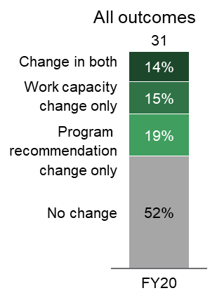
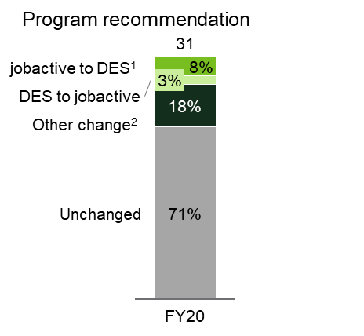
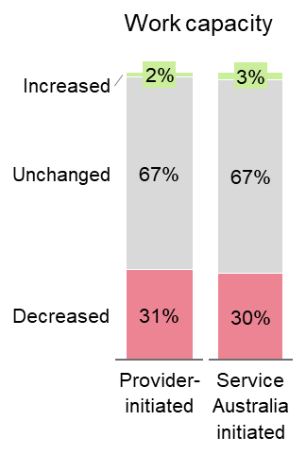
Change of Circumstances Review ESAts change program recommendation or work capacity 48 per cent of the time
2
Change of Circumstances Review (COCR)
2.1
COCR ESAts predominantly change program recommendation or work capacity in 48 per cent of assessments
Results of COCR ESAts, 2019-20 ('000)
13
per cent
of all ESAts
80
per cent provider initiated
COCR ESAts are a material proportion of all ESAts
Providers initiate majority of COCR ESAts
Note recommendations for non-DES programs are not binding
(see Section 3.3)
1. Approximately 4295 Stream C participants sent for a COCR, 54 per cent (i.e. 2,311) resulted in a DES recommendation. 2. Other change includes changes involving outcomes such as unable to benefit, pathway activities or ADE
Source: DSS; BCG analysis

Slide 40
Recommend ongoing monitoring of COCR ESAts
2
Change of Circumstances Review (COCR)
2.1
Selected options to manage change of circumstances ESAts
Clarify when to
initiate COCR
Increase reviews of
provider COCRs
Services Australia review prior to ESAt
Charge providers
for COCR ESAts
For example, emphasise new medical evidence should only be actioned if it is likely to change required supports or work capacity
Provide feedback to providers with high COCR ESAt referrals and low probability of changes
Services Australia officers review requests prior to ESAt being conducted
Charge providers for any ESAts which don't result in a change in program referral or work capacity
Source: ESAt and JSCI Instrument Overview; ESAt referral information; DSS; BCG analysis
Notes:
Recommended options are Clarify when to
initiate COCR, and Increase reviews of provider COCRs

Slide 41
Recommend ongoing monitoring of COCR ESAts
2
Change of Circumstances Review (COCR)
2.1
Selected options to manage change of circumstances ESAts (detail)
 | Clarify when to initiate COCR | Increase reviews of provider COCRs | Services Australia review prior to ESAt | Charge providers for COCR ESAts
Description | For example, emphasise new medical evidence should only be actioned if it is likely to change required supports or work capacity | Identify and provide feedback to providers who are referring high volumes of COCR ESAts, but a low probability of changes occurring based on these assessments | Services Australia officers review requests prior to ESAt being conducted, similar to current triaging process | Charge providers for any ESAts which don't result in a change in program referral or work capacity
Benefits | Services Australia still able to audit if COCR ESAts dramatically increase | May reduce volume of assessments | May reduce ESAt volumes | Provides very strong deterrent to additional ESAts
Drawbacks | Likely to have a smaller impact | Limited means to penalise providers for unwarranted ESAts Requires analytics effort, potentially IT build | Creates workload for Services Australia officers (but not ESAt assessors) | Providers unlikely to agree May lead to participants not being well supported
Implemented within current framework | No change to current DES Grant Agreement | No change to current DES Grant Agreement | No change to current DES Grant Agreement | Requires change to DES and jobactive Grant Agreement
Overall recommendation | Viable option | Viable option | Viable option | Not recommended
Source: BCG analysis

Slide 42
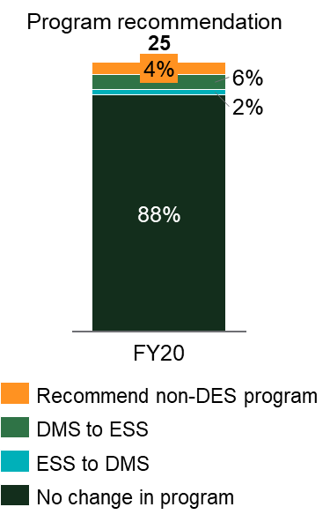
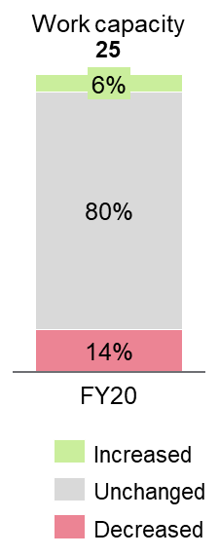
DES 18-Month Reviews provide little benefit, but cost ~$4m and disrupt the participant's employment journey
3
DES 18-Month Review
2
DES 18-Month Reviews drive workload,
cost and detract from participant experience
In recent years, 4 per cent of
18-Month Reviews result in exit from DES
18-Month Review ESAts ('000)³
9
per cent
of ESAt
volumes
Cost of ~$4m^{1,2}
4 per cent of reviews
result in DES Exit
Increases assessment volumes by 25k ESAts per year
Additional annual expenditure on ESAts
Disrupts employment services journey, stopping provider payments and support if ESAt not conducted before 18 months
1. Assumes 18m Review ESAts require 70% of the effort of a standard medical ESAt 2. Assumes $223 cost per ESAt based on 2012-13 data: assessment appropriations of $86.3m, assessment proportions of 10% ESAt, 55.5% medical ESAt, 34.5% JCA, task times of 47min, 69min and 106.5min respectively. Total assessment volume of 334,394 assessments 3. Excludes participants whose initial DES program referral was not present in the DES Data
Source: DSS; BCG analysis

Slide 43
Recommend removing DES 18-Month Review
3
DES 18-Month Review
2.1
Options to manage DES 18-Month Review
      Maintain current approach
      Conduct as a file assessment
      Nudge providers
      to request
      Target
      using analytics
      Remove 18
      Month-Review
Keep 18-Month Review process, potential to streamline paperwork
ESAt conducted
via a file assessment
SA prompts provider at 18 months about whether a review is beneficial
Use analytics to target reviews at cohorts most likely to change program recommendation
Remove the 18 Month-Review (providers can still initiate change of circumstances ESAt)
Viable alternative
(no provider consent)
Viable combined alternative (requires provider consent)
Recommended
(requires provider consent)
Source: ESAt and JSCI Instrument Overview; ESAt referral information; DSS; BCG analysis

Slide 44
Recommend removing DES 18-Month Review
3
DES 18-Month Review
2
Options to manage DES 18-Month Review (detail)
 | Maintain current approach | Conduct as a file assessment | Nudge providers to request | Target using analytics | Remove 18-Month Review
Description | Keep 18-Month Review process. Streamline ESAt paperwork for these ESAts | ESAt conducted via a file assessment | SA prompts provider at 18 months about whether a review is beneficial | Target reviews at cohorts most likely to change program (e.g. existing referral for another stream) | Remove the 18 Month-Review (providers can still initiate COCR ESAt)
Improves participant experience | No | Yes | Yes | Yes | Yes
Enables participants to exit DES after 18m | Yes | Partially | Partially | Mostly | No
Impact on DES caseload and expenditure¹ | Negligible volume and cost increase | Increase caseload by ~250 Increase cost by ~$1.5m | Increase caseload by ~100 Increase cost by ~$600k | Increase caseload by ~100 Increase cost by ~$600k | Increase caseload by ~500 Increase cost by ~$3m
Impact on ESAt effort^{2,3} | Limited reduction in assessor work effort | Reduce by ~$1.5m (40 per cent reduction in effort per ESAt) | Reduce by ~$2.3m (60 per cent reduction in volumes) | Reduce by ~$2.3m (60 per cent reduction in volumes) | Reduce by ~$3m (80 per cent reduction in volumes)
Implemented within current framework | No change to current DES Grant Agreement | No change to current DES Grant Agreement | Requires change to current DES Grant Agreement | Requires change to current DES Grant Agreement | Requires change to current DES Grant Agreement
Overall recommendation | Not recommended | Viable alternative (e.g. if providers do not agree) | Viable alternative (in combination) | Viable alternative (in combination) | Recommended
1. Assumes increased caseload results in $750 service fee per participant per quarter 2. Assumes 18m Review ESAts require 70% of the effort of a standard medical ESAt 3. Assumes $223 cost per ESAt based on 2012-13 data: assessment appropriations of $86.3m, assessment proportions of 10% ESAt, 55.5% medical ESAt, 34.5% JCA, task times of 47min, 69min and 106.5min respectively. Total assessment volume of 334,394 assessments
Source: DSS Data; DEEWR DHS ESAt Case Study 2012-13; BCG Analysis
Notes:
Recommended is remove 18-Month Review

Slide 45
Section 2.2
ESAt triaging
2.2
Observations
ESAt triaging process has changed since COVID-19, new automations are being introduced
  Pre-COVID, triaging was conducted during the participation interview and through subsequent manual processes
  Post-COVID, the JSCI is now conducted online by the participant. This means triaging effort previously performed during the participation interview must occur through other means
  Parts of this process have recently become automated through the introduction of a tool called "Screeni Bot", which is undergoing Business Verification Testing
  While BCG has not reviewed the operations of this tool, there are clear benefits to automation and it has been welcomed by Services Australia staff
Recommendations
  Continue improving the accuracy and efficiency of ESAt referrals triggered by the online JSCI. This could include adding new questions to the JSCI, or an alternative screening process
  Ensure the "Screeni Bot" automation is effective and integrates well within current operations (including passing Business Verification Testing). This should include ongoing auditing and recalibration
  As already planned by Services Australia, continue to build out complementary automations for ESAt booking and report writing
Source: BCG analysis

Slide 46
Triaging process is become increasingly automated, triaging during participation no longer occurs following the introduction of the digital JSCI
2.2
ESAt trigger during JSCI | Historical triaging was mostly manual | Changes underway to automate, impacted by digital JSCI
 | Pre-COVID: During the participation interview, Services Australia officer determines whether to request an ESAt as a JSCI flag E.g. reapply existing ESAt | Participation interview does not occur following introduction of the digital JSCI ("Job Seeker Snapshot") Services Australia and DESE exploring improvements
 | Confirm ESAt meets basic data-based medical rules E.g. receives income support, deceased, etc. Prioritise key participant segments for ESAt bookings e.g., homeless, domestic violence, etc. | Automated by"Screeni Bot" introduced in early August (undergoing Business Verification Testing)
 | Reviews participant's medical information to determine if an ESAt is required E.g. medical information, conditions temporary, properly diagnosed, etc. | Partially automated by “Screeni Bot” Services Australia officers conduct exceptions handling for complex cases
 | Book an ESAt for participants who pass the triaging process | Automated booking of ESAts through “Booky Bot” (expected 24 August)
1
Trigger leads to ESAt request
(pre-COVID):
33 per cent¹
Pre-COVID only: request in
participation interview
2
Triage: compliance
with rules
ESAt requests
leads to ESAt occurring
Pre-COVID:
50 per cent¹
Post-COVID:
31 per cent²
3
Triage:
medical
information
4
Refer
to ESAt
1. Includes JSCIs conducted by Services Australia due to registration or re-registration that result in an ESAt trigger. For JSCI and ESAt data between July 2018 and June 2020
2. From May 2020 to 5 August 2020. Based on data for DESE ESAts provided by Services Australia (57,104 ESAts received and 39,360 triaged as not being required)
Source: DESE Assessment, Services and Outcomes Branch; Services Australia Assessment Services Branch; BCG analysis

Slide 47
Potential to improve the accuracy and efficiency of ESAt referrals resulting from the online JSCI
1
Registration and JSCI
2.2
ESAt referral process changed after introducing the online JSCI
Potential opportunities for improvement
Can the new process trigger ESAts more accurately? That is:
  Reduce the number of unnecessary ESAts referrals
  Ensure ESAts are being triggered in all cases where they are of benefit
Can the efficiency of the new process be improved to reduce workload for Services Australia?
1. May occur with or without a JSCI reassessment depending on the circumstances 3. Stream determined by JSCI score
Source: ESAt and JSCI Instrument Overview; ESAt referral information; ANAO 'Qualifying for the Disability Support Pension'; BCG analysis

Slide 48
Next section: Chapter 3
1
Executive summary
Summary of recommendations
List of terminology
6
Chapter 1: Context and introduction
32
Chapter 2: Referrals (triggers and triaging)
47
Chapter 3: Program recommendations and work capacity
75
Chapter 4: Further opportunities for change
80
Chapter 5: Implementation and impact assessment
87
Appendix

Slide 49
Chapter 3 summary: Program recommendations and work capacity
3
  3.1. ESAt decision-making
Interviews with assessors and observations of ESAt assessments demonstrated that ESAts are performed to a high standard by appropriately qualified professionals. However, broad guidelines require a high degree of professional judgement, which introduces inconsistency.
Recommendations to ESAt decisions more accurate and more consistent include:
  Update ESAt guidelines to be clearer and have more specific criteria. For example, the Department could consider increasing focus on the impact of medical conditions on the ability to obtain or retain employment, prioritisation of medical barriers compared to other barriers, factors which should not be considered as part of the ESAt, and the ongoing support requirements for DES-ESS and DES-DMS;
  Provide more examples of correct ESAt decisions, aligned to updated program guidelines and covering more "borderline" cases.
  Section 3.2. Quality assurance
Services Australia currently has effective QA processes. However, changes in emphasis, including greater targeting, are necessary toembed any changes made to the program guidelines. Recommended changes to the QA process include:
  Use analytics to target assessor quality assurance activities;
  Conduct standardised testing across assessors using file assessments, with a focus on "borderline" decisions;
  Provide selective, data-based feedback to assessors to address bias;
  Collect data on actual hours worked (e.g. by work capacity band, disability type) to inform assessor training.
Section 3.3. Enforcement of ESAt results
Currently, a proportion of individuals continue to participate in DES, despite having previously had ESAts that recommended an alternative program. While this proportion is small, at well under 1 per cent, the increased scale of DES suggests that it could translate into costs of up to $8m per annum. It is recommended that the Department examine methods of encouraging providers to more thoroughly enact exits of such individuals.

Slide 50
Chapter 3: Program referrals and work capacity assessment

Slide 51
Section 3.1
ESAt decision-making: observations and recommendations
3.1
Observations
Broad program guidelines naturally lead to variation
between assessors
  Observations of ESAt assessments demonstrated that ESAts are performed to a high standard by appropriately qualified professionals
  Guidelines for program recommendations and work capacity assessments are broad, require professional judgement
  Data shows statistically significant variability between assessors
  Assessor observations highlight differing interpretations of the program recommendation guidelines
  Incentives encourage assessors to be conservative in work capacity assessments
Recommendations
  Update ESAt guidelines to be clearer and have more specific criteria.
  For example:
      Criteria which should not be considered e.g. employment service, duration in employment service, age
      More detail on when a medical condition should the primary barrier to employment compared to other factors (e.g. vocational barriers, other non-medical barriers, macroeconomic conditions)
      Emphasise that ESS eligibility should require substantive reasons to believe that a participant will require moderate to high DES ongoing support (rather than flexible ongoing support)
      Clarifications on the treatment of the "post-COVID" cohort
  Provide more examples of correct ESAt decisions, aligned to updated program guidelines and covering more "borderline" cases

Slide 52
Assessment observations highlighted opportunities to clarify guidelines
3.1
Assessors report they are confident in most cases
Assessors appear suitably qualified and highly competent
Individual assessors usually have clear view of recommended program between streams; participants with medical evidence and no major non-medical barriers streamed to DES
Borderline decisions involve difficult judgement on comparative impact of medical and non-medical barriers
Decision criteria based on ambiguous guidelines
Participant input informs whether medical condition impacts their employment, if non-medical barriers are the more significant barrier
Some assessors refer from Stream C to DES to "try something different"
Assessors more likely to recommend older participants into DES
Some assessors may refer to DES ESS based on permanence and complexity of medical conditions rather than the need for ongoing support
Current assessment implicitly incorporates participant motivation, despite not being part of the assessment criteria
Employment experience not explicitly included in DES referral guidelines
Participant demographics changed post COVID-19
Post-COVID cohort is seen as more employable, experienced and motivated. Assessors have not yet been given additional referral guidance for this cohort
Source: BCG observations of 11 ESAts conducted by 6 different assessors

Slide 53
Program recommendations: Interview observations (I/III)
3.1
A
B
C
Assessors appear suitably qualified and highly competent
  Assessors appear suitably qualified, even when assessing participants with conditions outside their specific domain of expertise (e.g. due to ability to draw on other assessors, able to review existing medical evidence)
  Assessors demonstrate strong understanding of the employment services programs
Individual assessors report they have clear view of recommended program between streams; participants with medical evidence and no major non-medical barriers streamed to DES
  DES decisions usually come down to whether they have a medical condition with supporting evidence, unless there is another complex non-medical barrier which needs to be sorted first (e.g. homelessness). Medical conditions usually make it obvious (e.g. autism usually belongs in ESS)
  Stream C decisions usually clear - participants with one or more complex non-medical barriers
  ESAt assessments viewed as much more straightforward than JCA assessments
Borderline decisions involve difficult judgement on whether medical or non-medical barriers are more impactful
  “Borderline” decision between DES vs job active are relatively infrequent ("I probably pause and really have
  to think about the most appropriate referral maybe
  once a week")
  Assessor judgement is required to determine whether non-vocation or medical barriers are more material
Source: BCG observations of 11 ESAts conducted by 6 different assessors

Slide 54
Program recommendations: Interview observations (II/III)
3.1
D
E
F
Participant input informs whether medical condition impacts their employment and whether non-medical barriers or medical barriers
  Decision on whether medical condition is a barrier to work often comes back to the participant “Yes, I have chronic anxiety. It's being treated. It might impact my ability to work but it should be fine. I'll try going back part time and then see”
  Input from participants is needed to determine severity of non-medical barriers and whether they need to be addressed to make participant job-ready
Some assessors refer Stream C participants to DES to “try something different”
  Multiple assessors stated they will refer an existing Stream
  C participant to DES to "try something new" if they have
  been unsuccessful in Stream C
  Sometimes assessors keep participants in Stream if
  participant says they are satisfied with their current provider
Assessors see older participants as very likely to be streamed into DES
  Assessors noted it was highly likely older participants
  (e.g. 55+) would be streamed into DES, as they often have multiple medical conditions
  Unclear whether assessment considers whether medical barriers are the primary barrier for this cohort or other factors
Source: BCG observations of 11 ESAts conducted by 6 different assessors

Slide 55
Program recommendations: Interview observations (III/III)
3.1
G
H
I
J
Some assessors may recommend DES ESS based on permanence and complexity of medical condition rather than the individual's need for ongoing support
  Some assessors assume participants will require "Moderate" or "High" ongoing support (and belong in DES ESS) based on severity of medical condition, although there may not be evidence this will be required
  Some assessors have commented that participants with conditions which may improve (but are still permanent) are streamed into DES DMS
Current assessment implicitly incorporates participant motivation, despite not being part of the assessment criteria
  Official criteria state that assessment shouldn't be incorporated into program recommendations or work capacity assessments
  However, assessors noted that in practice it is difficult to separate out motivation from other factors
Employment experience not explicitly outlined in DES referral guidelines
  Participants' employment history can indicate whether their medical conditions impact their ability to gain or retain employment
  This is not explicitly included in the DES referral guidelines, however in some cases this is considered by assessors
Post-COVID participant cohort is more employable, experienced and motivated
  Assessors view participants who lost their job due to COVID-19 as more employable, experienced and motivated "they'll get a job quickly once COVID-19 settles down"
  Some assessors indicate their questions for people who lost their job as result of COVID-19 focused on whether they previously needed support finding employment and/or were able to work full time to determine whether DES is appropriate
  Assessors haven't received feedback on their approach to participants who are unemployed as a result of COVID-19
Source: BCG observations of 11 ESAts conducted by 6 different assessors

Slide 56


DES recommendations require assessor judgement on whether conditions "substantially" impact employment
3.1
See appendix for further detail
ESAt guidelines for recommendation to employment services:
Entity | Employment Service | Summary of ESAt guidelines for recommendation to employment service
Jobactive | Streams A and B | Medical conditions don't impact ability to find employment Minimal to medium support required to overcome non-medical barriers Stream Services Job Seekers considered job ready
Jobactive | Stream C | May have unstable medical conditions which significantly impact ability to find employment Must have multiple or complex non-medical barriers to overcome Participants not considered job ready until barriers are addressed
Disability Employment Services | Disability Employment Service (DES) (DMS or ESS) | Participant must have temporary or permanent disability, illness or injury Condition must result in substantially reduced capacity to obtain or retain employment Must have work "with intervention" work capacity of 8+ with DES support Non-medical barriers must have stabilised sufficiently to benefit from DES
Australian Disability Enterprises | (ADEs) | Participants have severe medical barriers requiring a supported work environment who are able to work 8+hours in supported environment
Not applicable | Unable to benefit | Severe medical barriers meaning participant is unable to work more than 8 hours in supported work environment or open employment
Community development programme | Community Development Program | Participant located in a designated remote area as determined by the NIAA¹
1. National Indigenous Australians Agency
Source: ESAt JCA Guide to Determining Eligibility and Suitability for Referral to Employment Services

Slide 57
Interviews highlighted challenges of work capacity assessments
3.1
Underlying challenge in an assessment
There is inherent uncertainty in a participants work capacity which makes assessments challenging, even with very similar conditions
Separating work capacity from motivation is challenging
Limited information to inform decisions
Short assessment time and relatively limited medical
(compared to rigour required for DSP) leads to uncertainty
Limited recent work history for many participants makes work capacity assessments challenging
Assessors prefer to be conservative in their assessment
Assessors want to be sure participant will be able to maintain employment at the assessed work capacity
Some assessors are conscious of providers challenging high benchmark hours, see little downside in being conservative in their assessment
Source: BCG observations of 11 ESAts conducted by 6 different assessors, DSS; BCG analysis

Slide 58
Assessors also have broad, subjective guidelines to assessing work capacity
3.1
ESAt guidelines for assessing work capacity
Work capacity is defined in relation to any type of work, and is not limited by the work the customer usually performs or work available in the customer's area
All non-medical factors should be disregarded, except where directly attributable to an impairment
Person should be capable of reliably performing the assessed work capacity on a sustainable basis
  e.g. 26 weeks in open, unsupported employment
Work capacity should consider combined functional impacts of all permanent medical conditions, treat all conditions as stable
Bandwidths for work capacity corresponding to qualitative categorisation of functional impact¹
  i.e. no (30+),
  mild (23-29), moderate (15-22h),
  severe (8-14),
  extreme (0-7)
1. Future work capacity ("with intervention") will often be higher than baseline (pre-DES) capacity
Source: ESAt Operational Blueprint 'Assessing Work Capacity (008-06110020)'

Slide 59
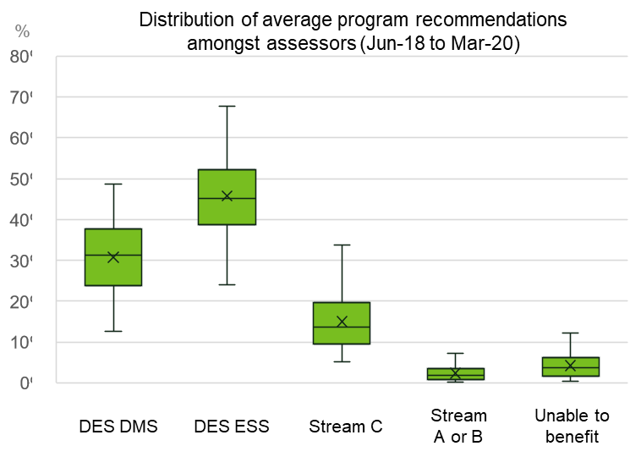
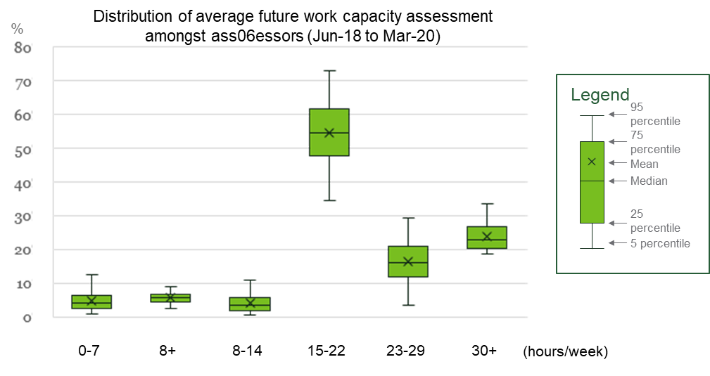
Summary data suggests substantial variation between assessors, but more thorough analysis needed to control for other variables
3.1
Average program recommendation rates vary by up to 50 percentage points across assessors
Similarly, future work capacity assessments can vary by up to 40 percentage points across assessors
However, such summary data does not control for variation in the job seeker population faced by each assessor
Note: Includes only assessors who have conducted 500 or more assessments in the period of Jun 2018 to Mar 2020 with no controls. Total of 448 observations.
Source: DSS; BCG Analysis

Slide 60
Regression findings suggest that assessors may vary substantially in their probability of recommending DES and assigning low work capacity0
3.1
    There is high variability in the way that assessors stream participants into DES or assign low work capacity
    Older participants are slightly more likely to be streamed into DES and assessed as low capacity
    Participants with barriers that are not related to their vocation or disability are less likely to be streamed into DES, but more likely to be assessed as low capacity if they are related to drug and alcohol and social isolation
    Participants are more likely to be streamed into DES over time²
    Participants are more likely to be assessed as low capacity if they have some form of disability, although the type of disability also affects the likelihood
1
  A statistical regression at least partially controlled for other factors¹ allows the extent of variation across assessors to be estimated
2
3
4
5
1. Factors controlled for include geography, age, volunteer status, gender, months unemployed; whether the participant was Indigenous, homeless, CALD, ex-offender or a refugee; primary disability type; barriers; referral reason; source of referral, outcomes of follow-up ESAts, time spent on Stream C, assessor credentials. 2. This is driven by the pre-vetting services introduced for DSP mid-2017 which drove ineligible DSP participants to enter DES instead. Note: While these findings should not be taken as comprehensive proof (as not all factors have been or can be controlled for), they are consistent with ESAt assessor interviews
Source: DSS; BCG analysis

Slide 61
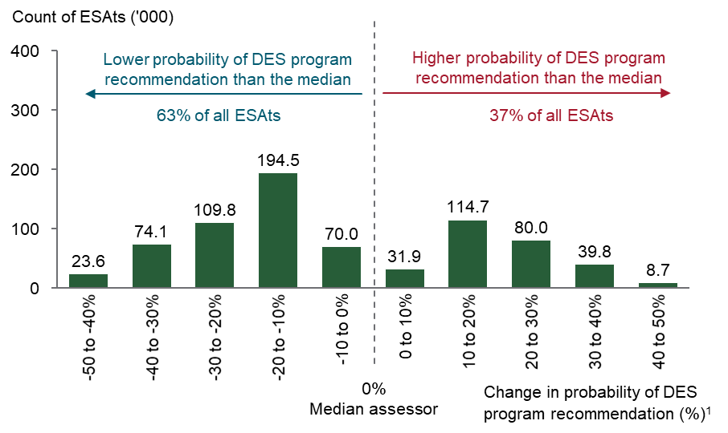
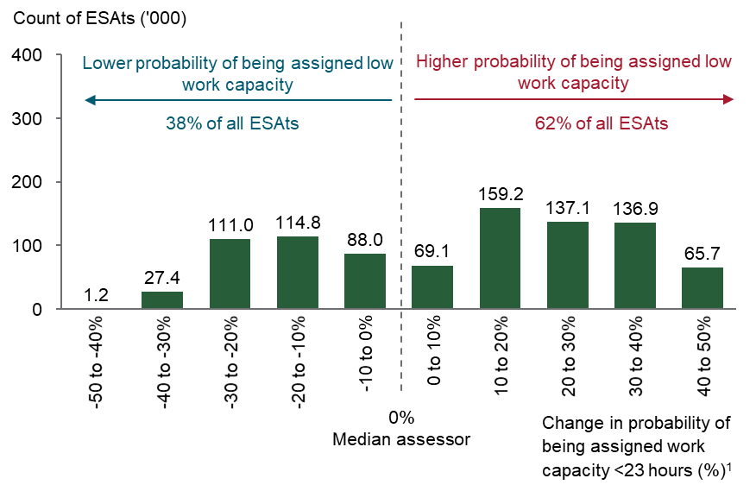
Regression suggests choice of assessor can have a substantial impact on whether an individual receives a DES program recommendation or a low work capacity
3.1
Choice of assessor can substantially impact probability of a DES recommendation, even after controlling for other variables06
Similarly, the choice of assessor can substantially impact probability of being assessed as work capacity
Distribution of tendency to provide a DES program recommendations
Distribution of tendency to assign low future work capacity (<23hrs)
1. Incremental percentage change from deviating from the median assessor (TB2720, AH0816) assuming all other variables are kept constant.
Note: factors controlled for include geography, age, volunteer status, gender, months unemployed; whether the participant was Indigenous, homeless, CALD, ex-offender or a refugee; primary disability type; barriers; referral reason; source of referral, follow-up ESAt, time spent on Stream C, assessor credentials
Note: only assessors that statistically differ from the median assessor included, as well as their respective assessments
Source: DSS; BCG analysis

Slide 62
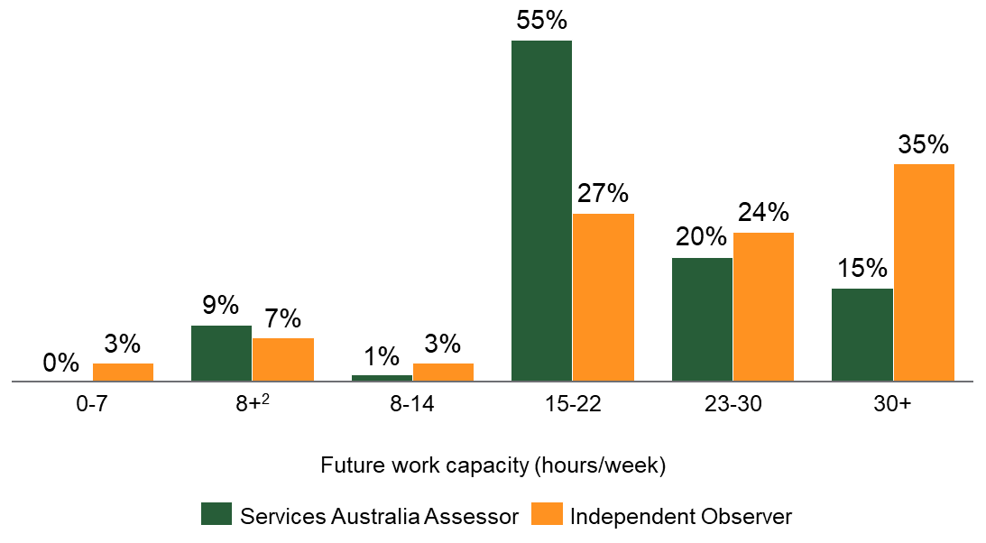
Services Australia assessors and independent observers had differing assessments of work capacity
3.1
Comparison of future work capacity assessments from Services Australia and independent observers¹
% of assessments
  Assessments of work capacity by independent observers were higher than those of Services Australia assessors
1. Based on approximately 320 assessments observed by Independent Assessors 2. Capacity of 8+ hours with DES Ongoing Support
Source: EY, 'DES Assessment Review Final Report'

Slide 63
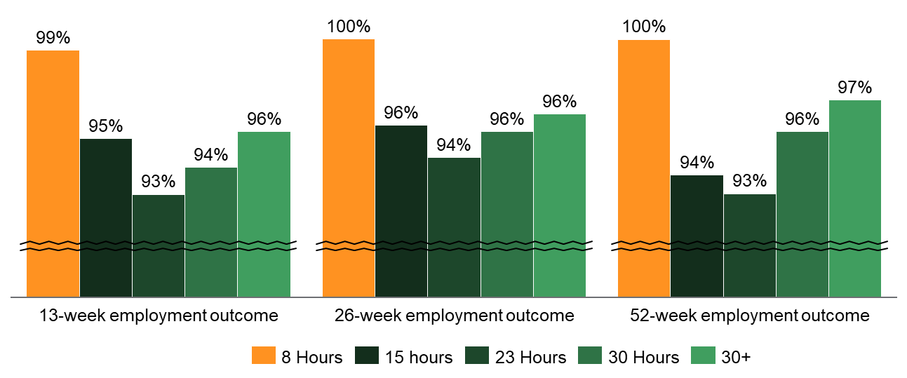
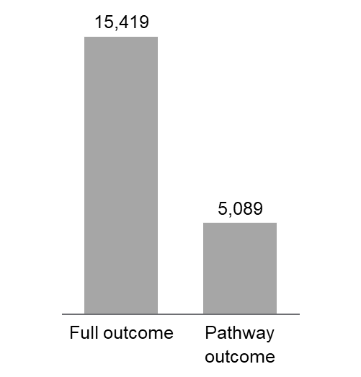
The bulk of DES participants who achieve employment outcomes do so at or above their assessed benchmark hours
3.1
Across all work capacity levels, strong tendency to achieve full, rather than
pathway, outcomes, implying work capacity consistently reached or exceeded
Pathway outcomes are one-third
of a full outcome payment
Full outcomes as a percentage of all outcome (%),
from Mar-19 to Mar-20
26 week outcome fee for
ESS 5 participant ($)
Source: DSS; BCG analysis

Slide 64
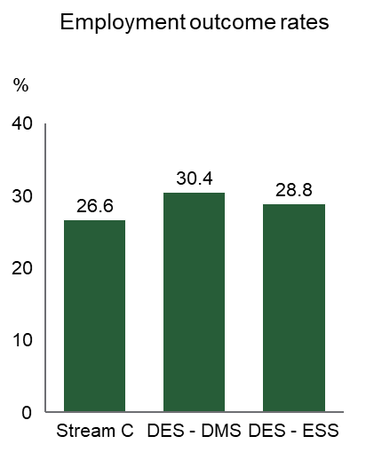
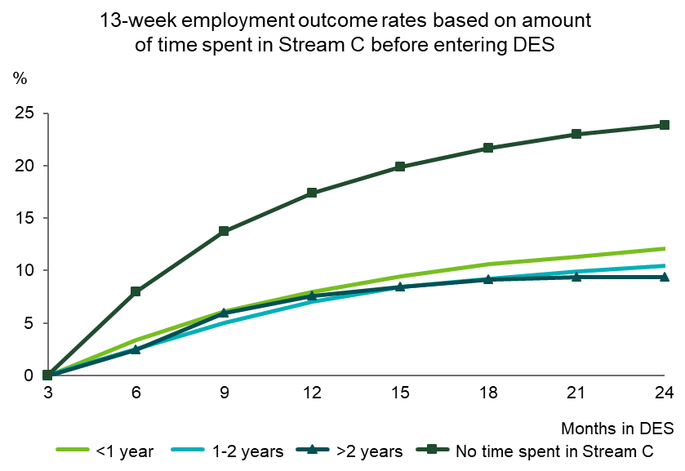
Transferees from Stream C to DES have substantially worse outcomes than the average DES participant
3.1
While Stream C and DES achieve similar outcome rates overall…
…transferees from Stream C are substantially less likely to achieve a 13-week employment outcome rate
For any given length of time in DES, former Stream C participants are half as likely to achieve a 13-week employment outcome than the rest of the DES cohort
However, it is difficult to conclude whether DES or Stream C is the less effective program for this cohort without observing their respective outcomes in Stream C
Total claims for all former Stream C participants in 2018-19 totaled $50.4m
Note: Former Stream C participants were identified by looking at COCR that resulted in a DES recommendation but the previous ESAt was Stream C. 7,607 former Stream C participants identified in DES (FY15-20). The difference in completion date between the two ESAts was used to determine the length of time a participant was in Stream C before transferring to DES. 3,149 has been in Stream C less than a year, 2,793 had been in Stream C between 1-2 years and 1,665 had spent more than 2 years in Stream C before transferring
Source: Employment Services Outcome Reports December 2018; DSS ; BCG analysis

Slide 65
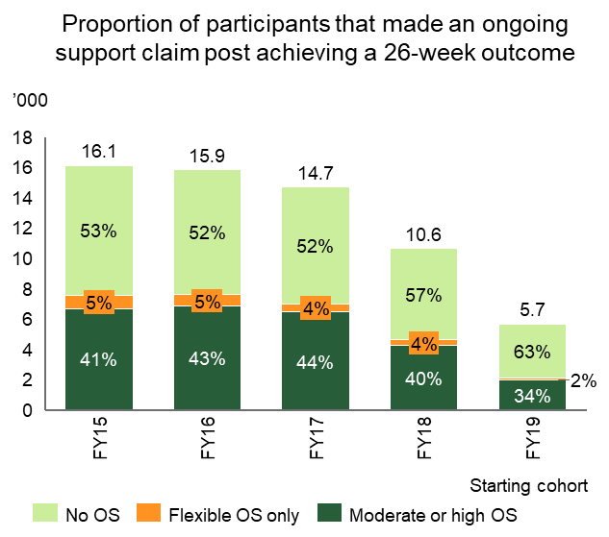
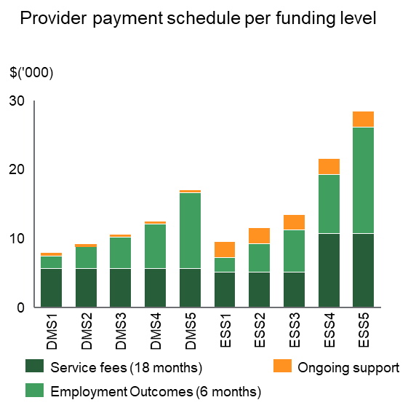
Most individuals referred to ESS do not ultimately receive moderate or high ongoing support
3.1
Over 50 per cent of ESS participants who achieved a 26-week employment outcome did not receive ongoing support (OS)
Service and outcome fees for FL4 & 5 in ESS are substantial higher than DMS
Current guidelines indicate that participants should be referred to ESS if it is expected that they will require moderate or high ongoing support to maintain their job.
However, less than 50 per cent of participants actually receive moderate or high ongoing support leading to the conclusion that most did not require the support
1,273 (22 per cent) of these outcomes are FL4&5. Only 347
(27 per cent) of these FL4&5 participants have moderate or high ongoing support
A reduction of ~$3m¹ in 26-week employment outcome costs would occur if those FL4&5 participants who did not receive high or moderate ongoing support started in DMS
1. Calculated based on the average difference between a DMS4&5 and ESS4&5 26-week employment outcome (i.e. $3,311) and the 926 ESS FL4&5 participants that did not make an high or moderate ongoing support claim post achieving their 26-week employment outcome.
Note: All 26-week employment outcomes achieved in the last 6 months of the dataset have been excluded, as participants may not have had sufficient time to incur an Ongoing Support claim.
Source: DSS ; BCG analysis
Notes:
Include FY19

Slide 66
Recommend ESAt guidelines are updated to provider clearer, more specific guidance on program recommendations
3.1
Program criteria | Current guidelines |  | Potential clarifications to consider
Condition materially impacts employment | Condition results in substantially reduced capacity to obtain or retain open employment Participant requires specialist assistance to build capacity to assist job seekers to work to their assessed future work capacity |  | Participants should not be referred to DES if they were previously able to obtain or retain employment at their assessed work capacity without specialist DES support and there has been no material change in their medical conditions
Prioritisation of factors | Non-medical barriers must have stabilised sufficiently to benefit from DES Not suitable for participants requiring long term assistance, or with multiple non-medical barriers |  | Participants with continuing non-medical barriers should not be referred to DES if there has been no improvement in these barriers Participants should not be streamed into DES where general unemployment barriers or macroeconomic conditions are the primary barrier to employment
Exclusions from program decisions | No clear guidelines as to whether age, duration in current employment service, duration of unemployment should be considered |  | The following factors must not be considered as part of the program recommendations: age, duration in current employment service, duration of unemployment
Ongoing support needs (for DES ESS) | Participant should be referred to ESS if it is expected that job seekers will require moderate or high ongoing support to maintain their job—i.e. a minimum of six contacts over each period of three months If the frequency of required support is unclear, the job seeker should be referred to Disability Management Service |  | Emphasise that ESS eligibility should require substantive reasons to believe that a participant will require moderate to high DES ongoing support (rather than flexible ongoing support) Unless clearly evidenced, a future deterioration in the participant's medical condition(s) should not be assumed
Source: BCG analysis; ESAt JCA Guide to Determining Eligibility and Suitability for Referral to Employment Services; ESAt Operational Blueprint 'Eligibility for DES (008-04030020)'

Slide 67
Recommend changes to ESAt guidelines within current framework in the near term, explore alternatives as part of broader DES reform
3.1
Spectrum of options for clarifying ESAt guidelines
Re-
iterate
  Re-iterate criteria which should not be considered under the current guidelines (e.g. current employment program)
  Provide new examples to assessors on the "correct" program recommendation, particularly in challenging assessments
  For example, participants who lost their job as a result of COVID, with multiple medical and non-medical barriers
Provide
examples
  Add more specify regarding what constitutes a "substantial impact" on their ability to obtain or retain employment
  Require more explicit requirements to consider the participant's ability to perform different types of work
Add specificity within
current guidelines
Provide guidance on specific
conditions and barriers
  Provide guidance on the assessment approach specific to a variety of conditions and barriers (e.g. specific approaches for mental health, limb injuries, etc.)
  Re-design ESAts to use a fundamentally different assessment approach e.g. greater focus on capability, points-based tables, use of certificates of capacity
Conduct a fundamental re-design
Source: BCG analysis

Slide 68
Providing assessors with additional examples could help clarify guidelines and improve consistency
3.1
Illustrative examples
Description | 61 year old male | 53 year old female | 33 year old male | 58 year old female
Medical conditions | Back injury, which causes participant pain when undertaking labour based work (incl. in previous role) | Chronic neck and back pain, which is medicated (can't perform manual labour) History of stomach cancer | Severe depression and anxiety | Hand surgery in 2016 (weak grip) Obstructive sleep apnea (treated by CPAP machine) Anxiety
Non-medical barriers | Limited educational history (completed year 10) | Nil | Long term unemployed Transient accommodation (moving between sister's and a friend's house) Limited education history (completed year 9) | Limited educational history (completed year 11, undertaking Cert II)
Employment history | Worked in building maintenance for 13 years (incl. gardening, labouring, cleaning) Left job in Sep '19 to relocate to a regional area History of obtaining and retaining employment without assistance | Worked in administrative roles as a contractor for 20 years Lost job as a result of COVID-19, unsuccessful in recent applications No history in employment services History of obtaining and retaining employment without assistance | Performed various retail, hospitality and labour jobs Currently in Stream (for 18m) | Employed from 2016-2019, including recent 12m in retail. Previous history from 2010-2015 Last participated in DES in 2016
Streaming Decision | ? | ? | ? | ?
Work capacity | ? | ? | ? | ?
Source: BCG analysis

Slide 69
Section 3.2
Quality assurance
3.2
Observations
Current QA processes appear effective, opportunities to increase focus to support other recommended changes
  Current processes appear to be working well, but adjustments may be needed to embed guideline changes
  Opportunities to learn from global best practice in other industries e.g. standardised testing across assess, using data to target QA on
  outlier assessors
  Services Australia have limited visibility over each assessor's long-run referral data, program-wide data or the cost of employment services
Recommendations
  Use analytics to target assessor quality assurance activities (e.g. comparison to overall program results, regional results, or to expected results after normalising for other factors)
  Conduct standardised testing across assessors using file assessments, with a focus on "borderline" decisions
  Provide selective, data-based feedback to assessors to address bias. For example, this could be informed by comparison of individual assessor results to program level results
  Collect data on actual hours worked (e.g. by work capacity band, disability type) to inform assessor training
Source: BCG analysis

Slide 70
Quality Assurance process appears effective, but recommend increasing focus to support other changes
3.2
 | Current approach appears suitable |  | Opportunities to increase focus
Sampling method | Standardised QA sampling of all experienced assessors Overall QA target of 2 per cent of all assessments Quality team observes a minimum of 2 assessments per assessor per quarter New assessors have all assessments they conduct monitored by the quality team Line managers monitor performance each assessor |  | Targeted sampling based on data and analytics, to complement random sampling At a minimum, review outliers compared to the average results (e.g., across all assessors, regionally) Alternatively, statistical methods such as logistic regression or machine learning can be used For example, targeted compliance is frequently for payment audits across financial services, healthcare and other industries
Test method | Quality team observes interviews, focuses on ensuring decisions are justified and reasoned Retrospective reviews of ESAt reports |  | Introduce standardised testing across all assessors to determine variability between assessors For example, this could be performed by having all assessors perform an ESAt "file assessment" for the same participant
Assessor feedback | Assessors receive detailed qualitative feedback from managers and quality team |  | Provide selective, data-based feedback to assessors to address bias. For example, this could be informed by comparison of individual assessor results to program level results For example, best-in-class recruitment functions analyse hiring information to minimise unconscious bias
1. As of 5 August 2020. Based on data for DESE ESAts provided by Services Australia (57,104 ESAts received and 39,360 triaged as not being required)
Source: Services Australia Assessment Services Branch; BCG Anaylsis

Slide 71
Behavioural changes can improve outcomes in many different applications
3.2
Virgin Atlantic experiment reduced fuel costs by up to 10
per cent
  Virgin Atlantic behavioural experiments reduced pilot fuel consumption by up to 10 per cent, depending on the treatment
  Experiment tested three progressive treatments
    Providing fuel use data to each pilot on a monthly basis
    Setting fuel use targets
    Donating to a pilot's chosen charity if they meet set targets
  Results shows all treatments were effective
Research showed recommendation engine increased bail sentencing accuracy
  US researchers examined how machine learning algorithms could improve bail sentencing decision making (whether a participant awaits trial at home or in jail, not the final case sentence)
  Judges were shown results of a recommendation engine after they had made decisions, and asked if they would change the results
  Policy simulation showed crime rates could be reduced by 25 per cent with no change in jailing rates; or jailing rates could be reduced by 42 per cent with no increase in crime rates
  Gains were possible while also significantly reducing the percentage of African-Americans and Hispanics in jail
Source: Gosnell, List & Metcalfe (2016) 'A New Approach to an Age-Old Problem: Solving Externalities by Incenting Workers Directly'; Kleinberg et al. (2017) 'Human Decisions and Machine Predictions'

Slide 72
5 principles to realise change
3.2
Update guidelines using behavioural language (use defaults, clear rules e.g. if X then Y) where discretion is not desirable.
    This could be supported by the Behavioural Economics Team of the Australian Government (BETA)
5
Test changes to guidelines and behavioural nudges before implementation. This can be done quickly e.g. 2 days
Create behavioural incentives, for example "nudging" outlier assessors
principles to realise
change
Reinforce changes through feedback and quality assurances
Target feedback based on desired outcomes. For example, target all assessors if consistency is desirable, specific segments if a particular outcome is undesirable

Slide 73
Section 3.3
Enforcement of ESAt results
3.3
Observations
ESAt referrals have not always been strictly enforced according to DES Grant Agreement Guidelines
  Guidelines specify that providers have the responsibility to exit participants if program services are no longer appropriate
  There is no automatic actioning of an ESAt referral or system checks, enforcement ESAt referrals requires provider action
  Providers do not always choose to action referrals to another program
  A preliminary estimate is that $5-8m could be saved annually if all non-DES ESAt outcomes were actioned by providers
Recommendations
  Examine opportunities to enforce Grant Agreement clauses regarding DES exits following an ESAt recommendation to another program
1. As of August 2020, this excludes pending and suspended participants
Source: BCG analysis

Slide 74
While ESAts during a period of service are binding under the Grant Agreement, provider action is required to enforce exits from DES
3.3
Rules surrounding ESAts and DES entry/exit:
During a period of service, there is no automatic actioning of an ESAt referral or system checks, providers have the responsibility to action
A valid ESAt is required upon entry into an Employment Services Program and participants will be granted entry to the program recommended by the ESAt assessment at the time. ESAts are valid for 2 years for the purposes of "assessing eligibility" however, are ongoing for the purposes of assessing work capacity
If an ESAt for a DES 18-Month Review recommends "that the Participant does not receive Extended Employment Assistance, then the Provider must perform a Provider Exit of the Participant" (DES Grant Agreement)
The outcome of
this ESAt generally enforced
Exit only happens when provider chooses to action. Currently, 0.61 per cent of DES caseload¹ have an ESAt referral to another program
If an ESAt for a COCR recommends "that Program Services are no longer an appropriate service for a Participant, the Provider must perform a Provider Exit of the Participant" (DES Grant Agreement)
1. As of August 2020, this excludes pending and suspended participants
Source: DSS, DES Grant Agreement

Slide 75
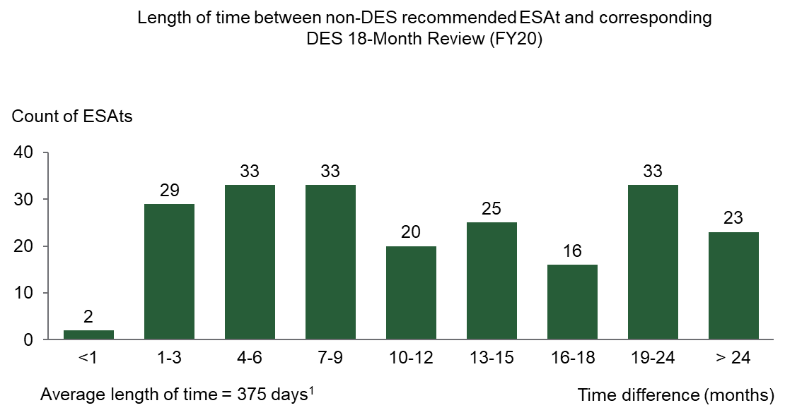
Preliminary estimate suggests savings of ~$5-8m annually in outcome and service fees if all follow-up ESAt referrals were enforced
3.3
Using the cohort who undertake 18-Month Reviews as a sample suggests a significant number have had non-DES recommendations months previously
If the Grant Agreement clause that "the Provider must perform a Provider Exit of the Participant" when an ESAt has suggested "that Program Services are no longer an appropriate service for a Participant" was strictly enforced, ~$5-8m could be saved annually
Note: Participants that have been suspended could have had follow-up ESAts more than 18 months before their DES 18-Month Review
1. This does not take into account of suspension time (equivalent to 1,347) of caseload have commenced in DES but have referrals to other programs
Source: DSS, BCG Analysis

Slide 76
New section
1
Executive summary
Summary of recommendations
List of terminology
6
Chapter 1: Context and introduction
32
Chapter 2: Referrals (triggers and triaging)
47
Chapter 3: Program recommendations and work capacity
75
Chapter 4: Further opportunities for change
80
Chapter 5: Implementation and impact assessment
87
Appendix

Slide 77
Chapter 4 summary: Further opportunities for change
4
DSS can consider a suite of broader-reaching changes, including:
  Conduct more extensive data-gathering to inform decision-making. This should consider the extent to which DES achieves outcomes above baseline for different cohorts, and the social value of employment outcomes, as per recommendations in the Mid-term DES Review. This will inform DES eligibility and ESAt design decisions. In addition, gathering data on work hours obtained by DES participants will inform assessments of the accuracy of work capacity decisions;
  Reconsider ESAt policy in the context of broader DES re-design. The Mid-term Review recommended that a number of changes be made prior to mid-2021, with farther-reaching program re-design implemented when the DES Grant Agreement expires in mid-2023. The ESAt process should be included in this re-design. Options for consideration could include removing the reliance on work capacity as a funding mechanism. However, other programs (jobactive, CDP) would presumably continue to rely on work capacity assessments, complicating any such change.
  Note that a number of issues relevant to effective ongoing management of ESAts were not investigated in detail as part of this review. This includes participant experiences, the balance of in-person interviews vs telephonic or other channels, and variations in ESAt effectiveness across geographies. The Department should continue to actively manage ESAts with respect to these and other issues going forward.
1. DSP application triggers are not considered in detail as part of this review
Source: BCG analysis

Slide 78
DES Review recommended consistent, systematic gathering of additional data, which would enable more effective decision-making on ESAts and eligibility
4
Several critical questions would be better informed by additional data-gathering.
Design of ESAt triggers closely linked to question of which cohorts should be eligible for DES.
ESAt trigger question | Possible data | Is data collected? | DES Review recommendation?
What would be the baseline employment outcome rates in the absence of DES? | Survey participants who obtain employment outcomes ("Is your employment attributable to your DES provider?") | No. Note similar data collected for jobactive | Recommendation 18. The Department should conduct regular surveys of program participants to assess extent that DES participation improves ability to obtain employment outcomes… Recommendation 19. The Department should regularly estimate the extent to which DES outcomes are an improvement above baseline.
How should the benefits of achieving employment be defined? | Aggregated impacts on wellbeing, life outcomes, income supports… (by cohort) | No | Recommendation 22. To further aid assessment of program performance, the Department should perform a quantitative assessment of the benefits of employment outcome achievement as a function of individual characteristics (age, experience, location, etc).
Which cohorts benefit most from participation in DES? | Combine observed employment rate improvements over baseline with benefits of employment (by cohort) | No | Same as recommendation 22 above
How much should the Commonwealth spend to support a given individual into employment? | Consequence of above estimates. | No | Recommendation 1. As a general principle, DES should target cohorts where the impact of assistance (compared to baseline outcomes) will be greatest, and seek maximum possible benefit for every dollar spent.
ESAt accuracy question | Possible data | Is data collected? | DES Review recommendation?
Do work capacity assessments align with hours eventually worked by participants? | One-off or ongoing survey of employment outcomes (hours worked per week) | No | Not addressed by DES Review. ESAt Review recommends that the Department conduct the suggested surveys at regular intervals (e.g. six monthly) to aid assessor calibration.
Note: Phrasing of recommendations adjusted for brevity.
Source: 2020 Mid-term DES Review, BCG analysis

Slide 79
Possible future changes to DES design could substantially impact design and function of ESAts
4
      DES Review recommended head-to-toe program redesign
  Re-design could at least potentially have significant implications for DES's dependency on ESAts
  For example: a shift to alternative remuneration models for providers, based on e.g. payments for total hours worked, would reduce the need for work capacity assessments, by eliminating "full" and "pathway" outcomes
  However:
    Other programs would likely still require work capacity assessments, e.g. CDP, jobactive
    Some ongoing measure of severity of disability, judged qualitatively via interview, would almost certainly still be required
  Such issues highlight the complexity and care that must be taken with any DES re-design
  Current DES Grant Agreement expires mid-2023
  Opportunity to substantially change program in coming years, ready to implement on grant expiry
  DES Review recommended including all aspects of program in re-design (eligibility, incentives, performance management…)
Source: 2020 Mid-term DES Review, BCG analysis

Slide 80
Ongoing monitoring and management of ESAts required to ensure efficacy and efficiency
4
  Various other concerns were raised during research for this Review. This includes:
  Participant experience. Recent research by Services Australia noted that for some participants, disclosing medical conditions (such as mental illness) to an ESAt assessor may be stressful or difficult, whether due to perceived stigma, cultural differences, or other reasons;
  Use of non-F2F channels:
    Particularly following COVID, the reliance on telephony to conduct ESAts was seen as a concern by some interviewees, as a potential additional barrier to effective information-sharing;
    Previous research has suggested that ESAts conducted by telephone continue to produce satisfactory results. However, ensuring that, at a minimum, a videoconferencing option is available may help balance overall program efficiency with the need to ensure a meaningful connection between assessors and participants.
  Regional variation. Experiences with ESAts for a CDP participant in a remote area may differ substantially from a DES participant in metro Sydney. Interviewees from the NIAA, for example, suggested that in remote regions there may be a greater tendency to over-estimate, rather than under-estimate, participant work capacity, partly due to the reasons outlined above.
  These issues were not investigated in detail as part of this Review. However, the Department should continue to actively monitor and manage these topics, among others, going forward.

Slide 81
New section: Chapter 5
1
Executive summary
Summary of recommendations
List of terminology
6
Chapter 1: Context and introduction
32
Chapter 2: Referrals (triggers and triaging)
47
Chapter 3: Program recommendations and work capacity
75
Chapter 4: Further opportunities for change
80
Chapter 5: Implementation and impact assessment
87
Appendix

Slide 82
Chapter 5 summary: Implementation and impact assessment
5
  This Review's recommendations are aimed at ensuring the scares specialist resources are targeted to those more in need of specialist support. This is particularly important given the impact of COVID-19 on unemployment rates.
  In addition, the changes will reduce the work effort required by Services Australia assessors, DES caseload and DES expenditure:
  Removing the DES 18-Month Reviews is expected to increase DES caseload by approximately 500 and costs by approximately $3.0m/year, while reducing assessor work effort by approximately 7 per cent or $3.1m;
  Changes to ESAt decision making criteria and quality assurance processes are expected to reduce the number of referrals to DES. However, quantifying this impact is difficult. As an example, a reduction in DES referrals of 2-7 per cent would reduce DES program expenditure by $25-90m in 2022-23.
  To realise these changes, the Department should incorporate best practices from behavioural economics, including testing changes prior to implementation and reinforcing them through feedback.
  Each of the Review's recommendations will require approvals and consultation with a range of stakeholders, including DSS, Services Australia, DESE, NIAA, Government and DES providers. Detailed design and implementation should consider the complex interactions between assessments and employment programs, including the impact on minority groups.
  Design work on the first set of changes (JSCI, 18-Month Review, ESAt guidelines) should start immediately, targeting full implementation by 1 April 2021. Later in 2021, the Department should proceed with medium-term improvements to the QA process and consider longer-term changes as part of broader reform to DES.

Slide 83
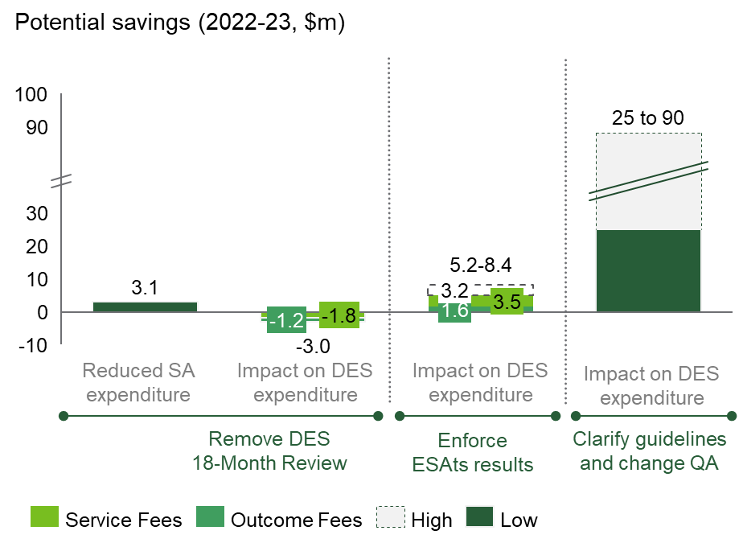
Recommended changes will have some impact on spend, but exact range is uncertain
5
Potential cost implications for removing 18-Month Review, enforcing Grant Agreement clauses regarding ESAts, clarifying DES referral criteria and changing QA processes
Potential savings is uncertain, depends on degree of change and strength of behavioural response
  Potential savings are inherently uncertain but can be firmed up through testing
  Changes to guidelines alone are likely to result in low, single digit changes in referral rates as they
  will likely still retain a degree
  of subjectivity
  Behavioural feedback can have a large impact, as people dislike being identified as outliers, however the strength of this response is uncertain
Illustrative savings assuming
2 to 7 per cent reduction in
DES referrals
Source: BCG analysis

Slide 84
Changes could reduce DES referrals by 2 to 7 per cent, depending on degree of change
5
1
    Research shows behavioural changes can lead significant, but variable changes in outcomes
    (see back-ups)
2 to 7%
2
    By comparison, regression results shows participants are 2.3 per cent more likely to be referred to DES for every decade increase in age. This indicates a reduction in this factor (or similar) is likely to result in a small reduction in DES referrals)
Reduction in DES
referrals from changes to
guidelines and QA
Range of impact should be determined through testing
1. BCG observations of 11 ESAts conducted by 6 different assessors
Source: DSS data; BCG analysis; BCG project experience; Gosnell, List & Metcalfe (2016) 'A New Approach to an Age-Old Problem: Solving Externalities by Incenting Workers Directly'; Kleinberg et al. (2017) 'Human Decisions and Machine Predictions'

Slide 85
Approvals and consultation needed across Government
5
Note, consulted in the below tables refer to "Consulted due to potential impact of changes"
Referrals (triggers and triaging)
Recommendation | DSS | Services Australia | DESE | NIAA | Government | Providers | IT Change
01) Ensure changes to the JSCI as part of the new jobactive model consider the impact on ESAt referrals | Consulted | Consulted | Approval rights | Consulted
02) Update the pre-listed medical condition JSCI triggers | Approval rights | Consulted | Consulted
03) Increase reviews of COCRs and clarify COCR guidance |  | Approval rights
04) Remove DES 18-Month Review | Approval rights | Consulted |  |  | Approval rights | Approval rights | Approval rights
05) Continue improving the accuracy and efficiency of ESAt referrals triggered by the online JSCI | Consulted | Consulted | Approval rights | Consulted |  |  | Approval rights
06) Ensure "Screeni Bot" is effective and integrates well | Consulted | Approval rights | Consulted | Consulted |  |  | Approval rights
07) Build out complementary automations for ESAt booking and report writing |  | Approval rights | Approval rights |  |  |  | Approval rights
Program referrals and work capacity assessments
Recommendation | DSS | Services Australia | DESE | NIAA | Government | Providers | IT Change
08) Update ESAt guidelines to be clearer and have more specific criteria | Approval rights | Approval rights | Consulted | Consulted
09) Provide more examples of correct decisions | Consulted | Approval rights | Consulted | Consulted
10) Use analytics to target assessor quality assurance | Consulted | Approval rights | Consulted | Consulted |  |  | Approval rights
11) Conduct standardised QA testing using file assessments | Consulted | Approval rights | Consulted | Consulted |  |  | Approval rights
12) Provide selective, data-based feedback to assessors to address potential bias | Consulted | Approval rights | Consulted | Consulted |  |  | Approval rights
13) Collect data on actual hours worked to inform training | Approval rights | Approval rights |  |  |  | Consulted | Approval rights
14) Examine opportunities to enforce Grant Agreement clauses regarding DES exits following alternate program referral | Approval rights
Further opportunities for change
Recommendation | DSS | Services Australia | DESE | NIAA | Government | Providers | IT Change
15) Conduct more extensive data-gathering | Approval rights | Consulted |  |  |  |  | Approval rights
16) Reconsider ESAt policy in context of DES re-design | Approval rights | Approval rights | Consulted | Consulted | Approval rights |  | Approval rights
Source: BCG analysis; DES Grant Agreement

Slide 86
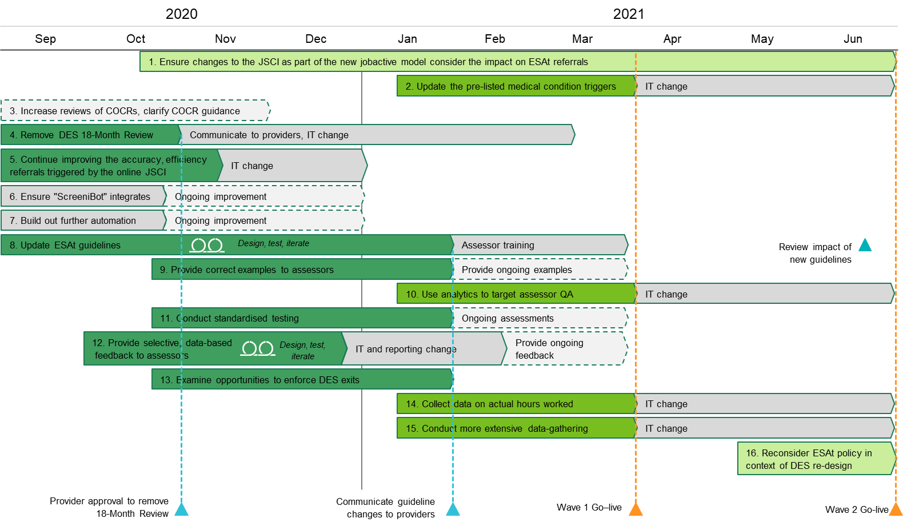
Implementation plan
5
ESAt referrals
Program referrals and work capacity assessments
Further opportunities for change
Key milestones
Wave 1 design
Wave 2 design
Long term design
Implementation
Go-live
Other milestones
Source: BCG analysis

Slide 87
Immediate next steps
5
Changes to program guidelines
  By 15 September 2020, complete the mobilisation phase, including:
  Standing up a dedicated team with DSS to implement changes to guidelines
  Agreeing the scope of changes
  Developing the project plan
  By 30 November 2020, draft minimum viable product of changes to the ESAt guidelines to test with assessors. This should include:
  Collaborating with Services Australia, the NIAA, DESE and other stakeholders
  Working with BETA to draft changes using clear behavioural language
  Obtaining guidance from BETA on how to test and iterate these with assessors
  By 23 December, complete initial testing of new guidelines with assessors
  By 31 January 2020, finalise new guidelines and update the operational blueprint
  By 1 April 2021, complete assessor training and launch the new ESAt guidelines
Other changes
  By 31 October 2020, obtain provider approval to remove the DES 18-Month Review
  By 15 November 2020, test the provision of data based feedback on ESAt outcomes to assessors (and their supervisors)
  By 15 November 2020, finish designing improvements to the process for ESAt referrals resulting from the online JSCI, for implementation in January 2021
  By 31 March 2021, implement high priority changes to the QA process (feedback, standardised testing)
  By 30 June 2021, start conducting targeted QA based on analytics, update the ESAt triggers list and collect additional data
1
2
3
4
5
6
7
8
9

Slide 88
New section: Appendix
1
Executive summary
Summary of recommendations
List of terminology
6
Chapter 1: Context and introduction
32
Chapter 2: Referrals (triggers and triaging)
47
Chapter 3: Program recommendations and work capacity
75
Chapter 4: Further opportunities for change
80
Chapter 5: Implementation and impact assessment
87
Appendix

Slide 89
The ESAt Review was completed in four weeks over July and August 2020
Source: BCG analysis

Slide 90
Backup: DES recommendations require assessor judgement on whether conditions "substantially" impact employment
ESAt guidelines for recommendation to employment services
Employment Service | Medical conditions | Other barriers | Support requirements | Work capacity | Other
Jobactive (Streams A & B) | Yes, if medical conditions don’t impact ability to find employment | Minimal to medium support to overcome barriers Consider other services if barriers are present | No minimum requirement Job seekers may have short term support requirements | May have a reduced work capacity Work capacity less than 15 hours may volunteer | Stream Services job seekers are considered to be comparatively job ready (noting varying degrees of barriers)
Jobactive (Stream C) | May have unstable conditions which significantly impact ability to find employment | Must have multiple and or complex non-medical barriers | No identified employment support requirements | May have a reduced work capacity Work capacity less than 15 hours may volunteer | Primary focus on addressing complex non-medical barriers Participants not job ready until barriers addressed
Disability Employment Services (DMS or ESS) | Temporary or permanent disability, illness or injury Condition results in substantially reduced capacity to obtain or retain open employment | Sufficiently stabilised for participant to benefit from DES Not suitable for jobseekers requiring long term assistance, or with multiple or complex non-medical barriers | DES participants receive 26 weeks post-placement support May require ongoing support to maintain employment | “With intervention” work capacity above 8 hours per week or 8+ with DES ongoing support) | Requires specialist assistance to gain or retain employment and/or to build capacity to work to their assessed future work capacity
Australian Disability Enterprises | Severe medical conditions | Severe medical barriers | Requires a supported work environment | “With intervention” work capacity of 0-7 hours in open employment, but 8+ hours in a supported work environment | May require specialist assistance to gain employment
Unable to benefit | Severe medical conditions | Severe medical barriers | Unable to work more than 8 hours (with support) | "With intervention" work capacity of 0-7 hours per week | Not suitable for ADEs or DES with ongoing support
Note: Referral to CPD is based on geographic location only
Source: ESAt JCA Guide to Determining Eligibility and Suitability for Referral to Employment Services

Slide 91
Backup: ESAts also recommend whether participant is streamed into
DES-ESS or DES-DMS
ESAt guidelines for recommendation to employment services
Employment Service | Medical conditions | Other barriers | Support requirements | Work capacity | Other
Disability Employment Services (Disability Management Service) | Temporary or permanent disability, illness or injury Condition results in substantially reduced capacity to obtain or retain open employment | Sufficiently stabilised for participant to benefit from DES Not suitable for jobseekers requiring long term assistance, or with complex or multiple non-medical barriers are not suitable | Participants require less than 6 instances of ongoing support per 6 months, or have unclear requirements Participants who require "personal care" are not eligible for DMS | "With intervention" work capacity above 8 hours per week | Requires specialist rehabilitation assistance to gain or retain employment and/or to build capacity to work to their assessed future work capacity
Disability Employment Services (Employment Support Service) | Permanent disability, illness or injury Condition requires ongoing support to stay in open employment | As per DMS | Participants require at least 6 instances of ongoing support per six months | "With intervention" work capacity above 8 hours per week (incl. 8+ with DES Ongoing Support) | Require specialist assistance to build capacity to assist job seekers to work to their assessed future work capacity
Source: ESAt JCA Guide to Determining Eligibility and Suitability for Referral to Employment Services

Slide 92
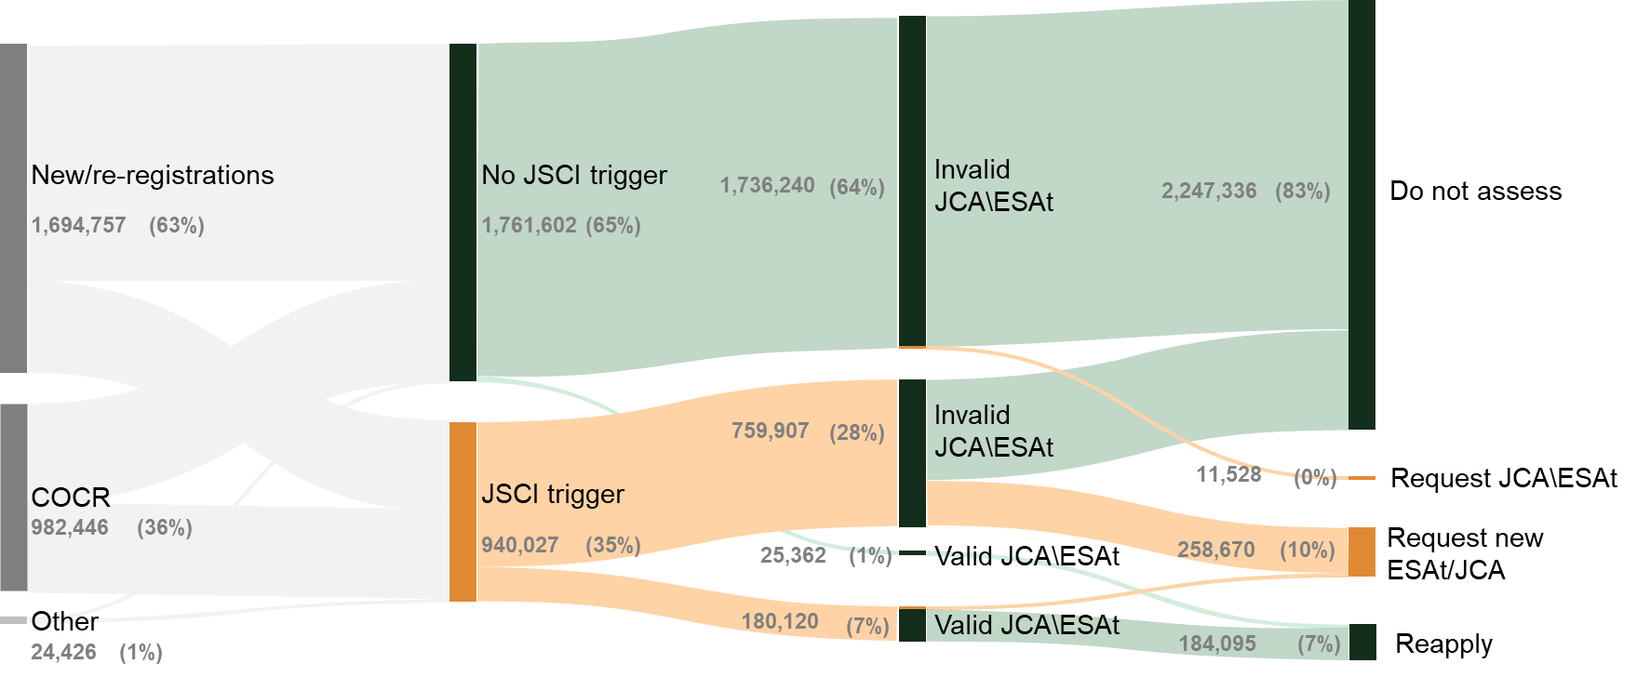
Approximately 10 per cent of JSCIs result in an ESAt/JCA referral
1
Registration and JSCI
Observed flow of JSCI to ESAt referral (FY19-20)
Note: Not all ESAts are triggered through JSCIs
Source: JSCI Data, BCG Analysis

Slide 93
Interpretation of results: Program recommendation and work capacity regressions
Interpretation of coefficients
  A logistical regression has been used to estimate the probability of a participant being recommended into DES, based on a range of characteristics
  Coefficients from this logistic model have been converted to be expressed as incremental changes in probability, for individuals for whom there would otherwise be a 50 per cent change of being recommended into DES
  All categorical variables have a reference category. The reference category is the "missing" category in the x-axis (e.g. the reference category for
  gender is female)
  For continuous variables such as age and months unemployed the coefficient is interpreted as incremental changes. Age is expressed in units of decades, months unemployed in 6 month increments, and time spent on Stream in years.
  For example, an incremental probability of 5 per cent implies that:
    For binary variables, observing the variable given would be associated with a change in the estimate of the probability of being streamed into DES from 50 to 55 per cent
    For continuous variables, a one-unit increase (e.g. one decade) would result in an equivalent increase in probability
  A similar model was used to calculate the incremental likelihood of being assessed as low work capacity.
Interpretation of significance
  Statistical significance is, speaking roughly, the probability of observing the data given, if the true value of the coefficient governing the statistic relationship between the variables was zero
  In the following pages, variables that are flagged as insignificant do not appear to have a statistical relationship with DES streaming decisions.
Interpretation of model fit
  True positive and true negative rates are measurements of well the model can predict the observed outcomes:
    The true positive rate measures the proportion of "positive" results (e.g. recommending DES or low work capacity) that were correctly identified
    Likewise, the true negative rate measures the proportion of negative results that were correctly identified
  Values closer to "1" suggest better performance. A positive prediction is taken as all those where the model's assigned probability was greater than
  50 per cent
  Note that no out-of-sample predictions were made, a step that would be necessary to calibrate model performance before e.g. using a similar approach to support QA

Slide 94
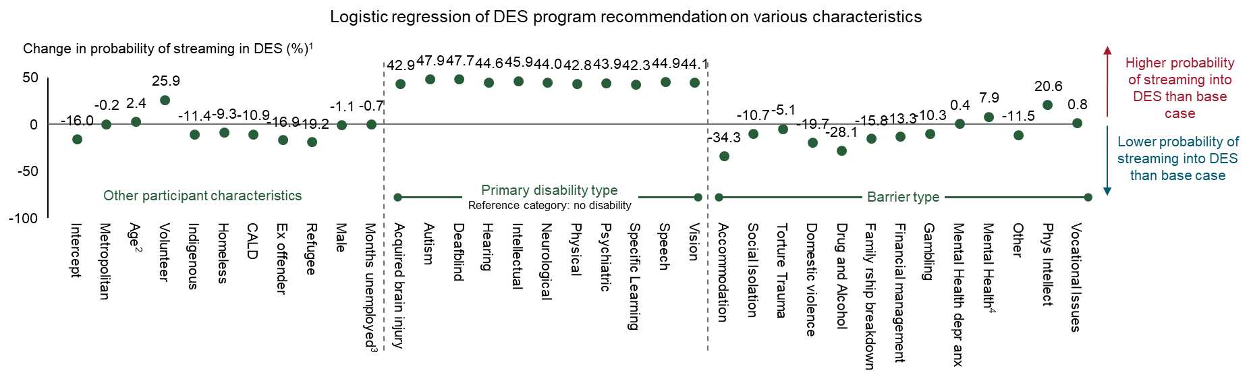
Program | Deep-dive: regression results for participant characteristics
Example: Every additional decade in age, on average adds 2.4 percentage points to the probability of being streamed into DES
Example: Having a hearing disability on average adds 44.6 percentage points to the probability of being streamed into DES
Example: Having a drug & alcohol barrier on average subtracts 28.1 percentage points to the probability of being streamed into DES
Model fit⁵
True positive: 0.9239
True negative: 0.8070
P-value
<0.001
<0.01
<0.05
>0.05
1. Incremental percentage change from deviating from the reference category assuming all other variables are kept constant. 2. Age has been converted to decades 3. Months has been converted to 6 month intervals 4. Anxiety & depression. 5. True positive is the ability of the model to correctly identify those referred to DES, whereas true negative is the ability of the model to correctly identify those not referred to DES. Note: n= 1.23m, only ESAt outcomes for DES DMS, DES ESS and Stream C have been included in this analysis
Source: DSS; BCG analysis

Slide 95
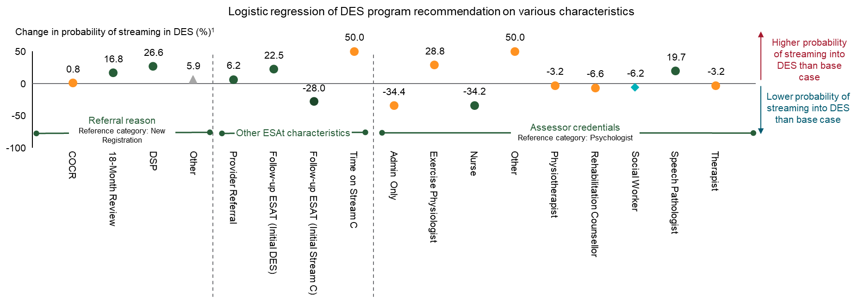
Program | Deep-dive: regression results for non-participant characteristics
Example: 18-Month Review ESAt on average adds 16.8 percentage points to the probability of being streamed into DES
Example: ESAt referrals from employment service providers on average adds 6.2 percentage points to the probability of being streamed into DES
Model fit²
True positive: 0.9239
True negative: 0.8070
P-value
<0.001
<0.01
<0.05
>0.05
1. Incremental percentage change from deviating from the reference category assuming all other variables are kept constant. 2. True positive is the ability of the model to correctly identify those referred to DES, whereas true negative is the ability of the model to correctly identify those not referred to DES. Note: n= 1.23m, only ESAt outcomes for DES DMS, DES ESS and Stream C have been included in this analysis
Source: DSS; BCG analysis

Slide 96
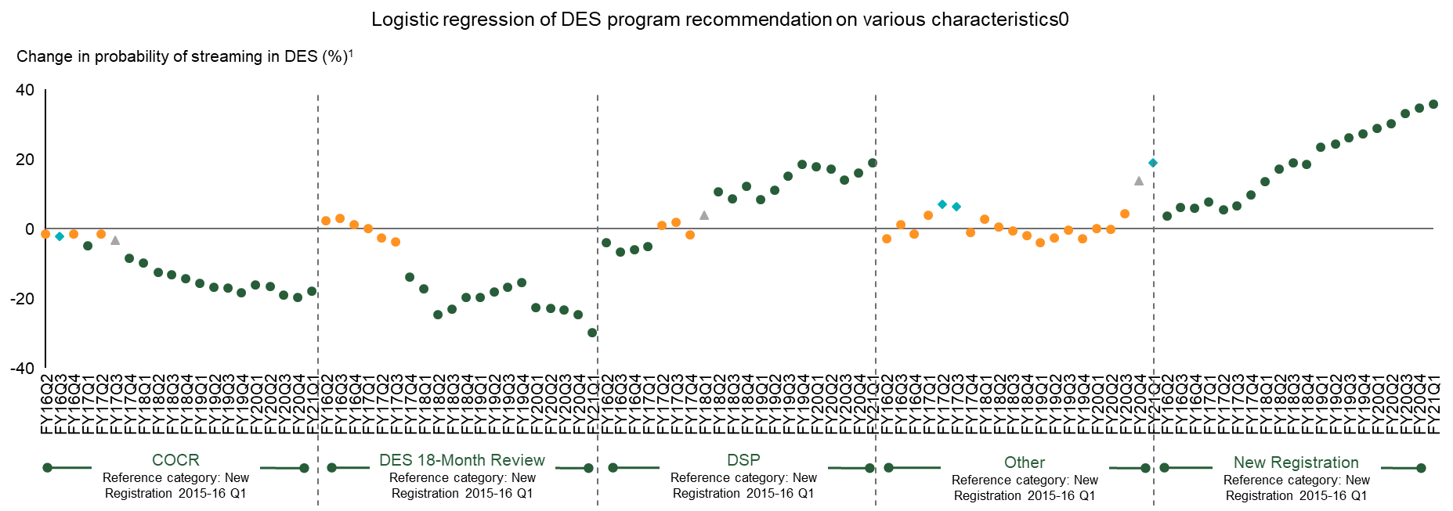
Program | Deep-dive: regression results for time
This upwards trend is driven by pre-vetting services for DSP introduced in May 2017 which resulted in ineligible DSP participants taking the ESAt instead
Model fit²
True positive: 0.9239
True negative: 0.8070
P-value
<0.001
<0.01
<0.05
>0.05
1. Incremental percentage change from deviating from the reference category assuming all other variables are kept constant 2. True positive is the ability of the model to correctly identify those referred to DES, whereas true negative is the ability of the model to correctly identify those not referred to DES. Note: n= 1.23m, only ESAt outcomes for DES DMS, DES ESS and Stream C have been included in this analysis
Source: DSS; BCG analysis

Slide 97
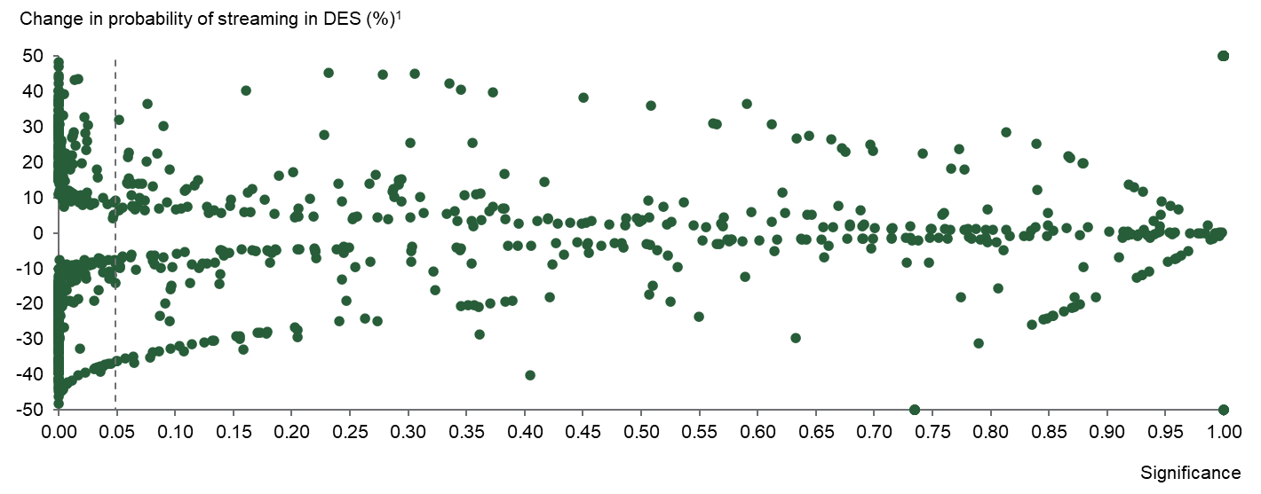
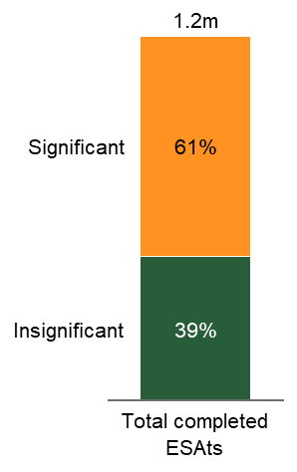
Program recommendation | Deep-dive: substantial variation in size and significance of "assessor effect"
Holding other variables constant, the assessor themselves vary in their likelihood of recommending DES
Majority of ESAts conducted by assessor who differed significantly from the median
Distribution of assessor variation in recommending DES
540 assessors differ significantly from the median assessor
1. Incremental percentage change from deviating from the median assessor (TB2720) assuming all other variables are kept constant. Note: n=1.23m, with 1,032 unique assessors from 2015-16 to 2019-20. Only ESAt outcomes for DES DMS, DES ESS and Stream C have been included in this analysis.
Source: DSS; BCG analysis

Slide 98
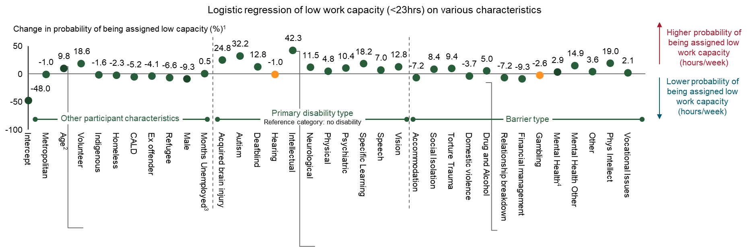
Work capacity | Deep-dive: regression results for participant characteristics
Every additional decade in age, on average adds 9.8 percentage points to the probability of being assessed as low capacity
Having an intellectual disability on average adds 42.3 percentage points to the probability of being assessed as low capacity
Having a drug & alcohol barrier on average adds 5.0 percentage points to the probability of being assessed as low capacity
Model fit⁵
True positive: 0.8238
True negative: 0.7061
P-value
<0.001
<0.01
<0.05
>0.05
1. Incremental percentage change from deviating from the reference category assuming all other variables are kept constant. 2. Age has been converted to decades 3. Months has been converted to 6months intervals 4. Anxiety & depression. 5. True positive is the ability of the model to correctly identify those assigned low work capacity, whereas true negative is the ability of the model to correctly identify those assigned high work capacity. Note: n= 1.23m, only ESAt outcomes for DES DMS, DES ESS and Stream C have been included in this analysis
Source: DSS; BCG analysis

Slide 99
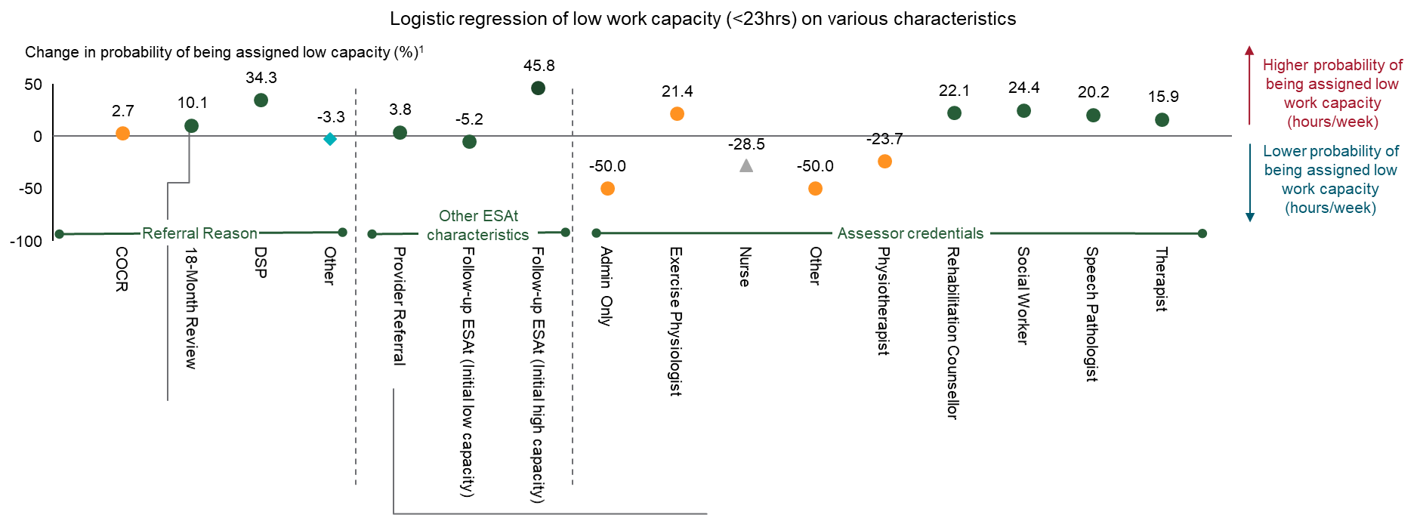
Work capacity | Deep-dive: Regression results for non-participant characteristics
18-Month Review ESAt on average adds 10.1 percentage points to the probability of being streamed into DES
ESAt referrals from employment service providers on average adds 3.8 percentage points to the probability of being streamed into DES
P-value
<0.001
<0.01
<0.05
>0.05
Model fit⁵
True positive: 0.8238
True negative: 0.7061
1. Incremental percentage change from deviating from the reference category assuming all other variables are kept constant. 2. Age has been converted to decades 3. Months has been converted to 6months intervals 4. Anxiety & depression. Note: n= 1.23m, only ESAt outcomes for DES DMS, DES ESS and Stream C have been included in this analysis
Source: DSS; BCG analysis

Slide 100
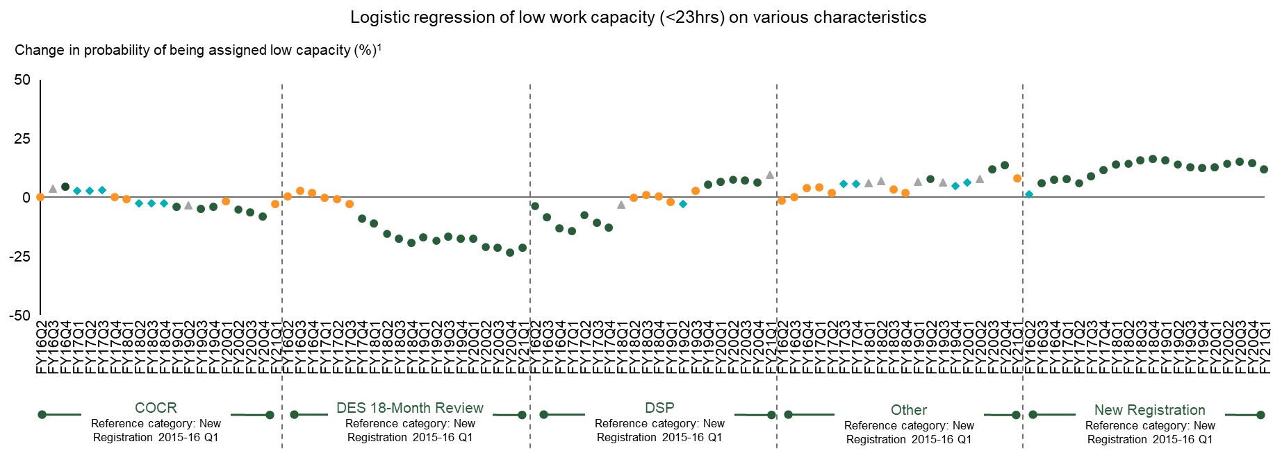
Work capacity | Deep-dive: regression results for time
P-value
<0.001
<0.01
<0.05
>0.05
Model fit⁵
True positive: 0.8238
True negative: 0.7061
1. Incremental percentage change from deviating from the reference category assuming all other variables are kept constant. 2. Age has been converted to decades 3. Months has been converted to 6months intervals 4. Anxiety & depression. 5. True positive is the ability of the model to correctly identify those assigned low work capacity, whereas true negative is the ability of the model to correctly identify those assigned high work capacity. Note: n= 1.23m, only ESAt outcomes for DES DMS, DES ESS and Stream C have been included in this analysis
Source: DSS; BCG analysis

Slide 101
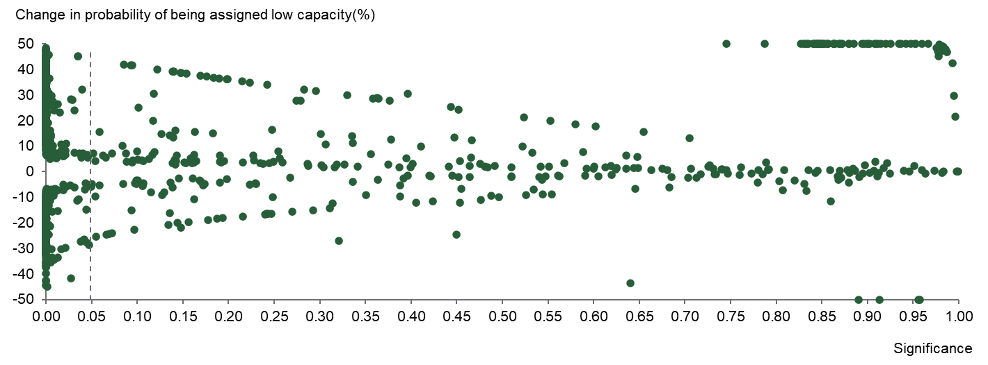
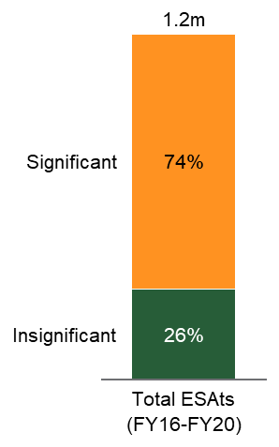
Work capacity | Deep-dive: substantial variation in size and significance of "assessor effect"
Holding other variables constant, the assessor themselves vary in their likelihood in assigning future work capacity
Majority of ESAts conducted by assessor who differed significantly from the median
Distribution of assessor variation in assigning future work capacity
647 assessors differ significantly from the median assessor
1. Incremental percentage change from deviating from the median assessor (AH0816) assuming all other variables are kept constant. Note: n = 1.23m, with 1,032 unique assessors from 2015-16 to 2019-20. Only ESAt outcomes for DES DMS, DES ESS and Stream C have been included in this analysis
Source: DSS; BCG analysis

Slide 102
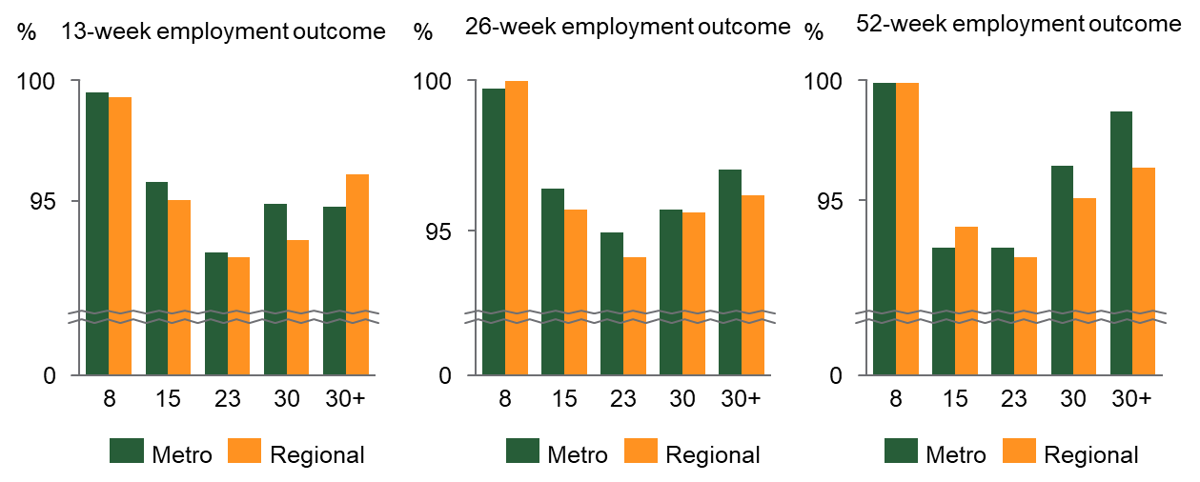
Minor difference in attainment of full vs pathway outcomes in regional vs metro areas
Regional DES participants who achieve employment outcomes are slightly less likely than metropolitan counterparts to do so at their assessed benchmark hours
Full outcomes as a percentage of all outcome (Mar-19 to Mar-20)
While assessed work capacity could be an accurate reflection of a participant's ability, the availability or seasonality of work in regional areas may make it more difficult for participants to work at or above their benchmark hours
Source: DSS; BCG Analysis

Slide 103


Participants referred to DES are increasingly older, compared to Stream C
The average age of a participant referred to
Stream C has fallen by 0.5 years since 2016-17
The average age of a participant referred
to DES has increased by 0.4 years since FY17
Note: Age refers to age at point of referral.
Source: DSS; BCG analysis

Slide 104


Participants referred DES are increasingly assessed as less capable of 23+ hours of work per week than previously
Share of referrals to Stream C assessed as capable of
full-time work has remained broadly steady…
…while referrals to DES are increasingly dominated by the 15 – 22 hour bracket, with an overall fall in average hours
Note: Assumes NA = 30+ capacity. 8+ work capacity category is for DSP participants. Average hours is calculated assuming the lower end of the hours/week range
Source: DSS; BCG analysis

Slide 105


In particular, participants with a disability are increasingly likely to receive program recommendation for DES over Stream C
More participants with a disability receive a DES program recommendation…
…and participants are, on average,
receiving lower estimated work capacity
Note: Unable to be completed ESAts have been removed from this analysis. Other refers to all other outcomes except DES and Stream C, such as Stream A & B, Unable to benefit, ADE, etc. Assumes NA is 30+ work capacity. 8+ is for DSP participants
Source: DSS; BCG analysis

Slide 106
Disclaimer
This report has been specifically created for the Commonwealth Department of Social Services (DSS). The purpose of this report is to provide general and preliminary information, and its contents should not be relied upon or construed as such by DSS or a third party. The contents of this report are disclosed in good faith, and subject to change without notice. The report does not contain a complete analysis of every material fact on the subject matter, and all warranties, representations and guarantees pertaining to the reliability, timelines, suitability, accuracy or completeness of its contents are expressly disclaimed. BCG, its subsidiaries and affiliates disclaim all liability relating to or arising from access, use or reliance on this report. The DSS is solely responsible for its interpretation of, and decisions taken, based on this report. Except for claims which cannot be capped at law, in no event will BCG, its subsidiaries and affiliates be liable for direct, indirect, incidental, special or consequential losses arising from the information in this report, whether arising out of contract (including under an indemnity), tort (including negligence), statute, strict liability, third party claims or otherwise, resulting from or related to this report, whether or not such party knew of should have known of the possibility of any such damages.

Slide 107
Thank you

